Slide 1
Supervised5 Kernel methods Support Vector Machine
資料科學 Data Science
張家銘 Jia-Ming Chang
政治大學資訊科學系
The slide isonly for educational purposes. If any infringement, please contact me, we will correct immediately.

Slide 2
Copyright declaration 版權說明
Some of the figures in this presentation are taken from "An Introduction to Statistical Learning, with applications in R" (Springer, 2013) with permission from the authors: G. James, D. Witten, T. Hastie and R. Tibshirani.
The web site of the book
The credit of individual is indicated in the bottom part of the slide.
ie.,

Slide 3
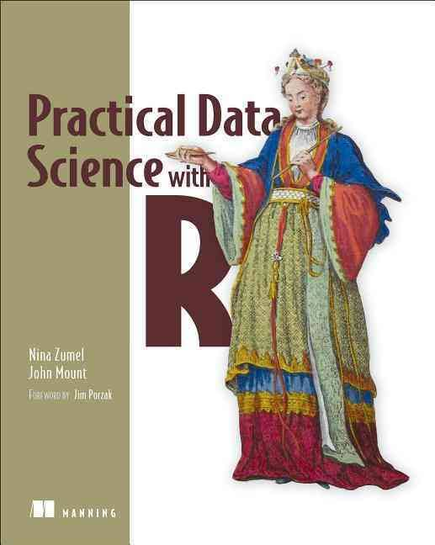
Copyright declaration 版權說明
Some of the figures in this presentation are taken from "Practical Data Science with R (Manning, 2019)”
The web site of the book
The credit of individual is indicated in the bottom part of the slide.
ie.,

Slide 4
Copyright declaration 版權說明
Some of the figures in this presentation are taken from "R for Data Science” under the Creative Commons Attribution-NonCommercial-NoDerivs 3.0 License.
The web site of the book
The credit of individual is indicated in the bottom part.
ie.,

Slide 5
Recap for the last week

Slide 6
Weaknesses of the basic approaches
Training variance
Reducing training variance with bagging and random forests
Non-monotone effects
Learning non-monotone relationships with generalized additive models
Linearly inseparable data
Increasing data separation with kernel methods
Modeling complex decision boundaries with support vector machines
Practical Data Science with R by Nina Zumel, John Mount

Slide 7
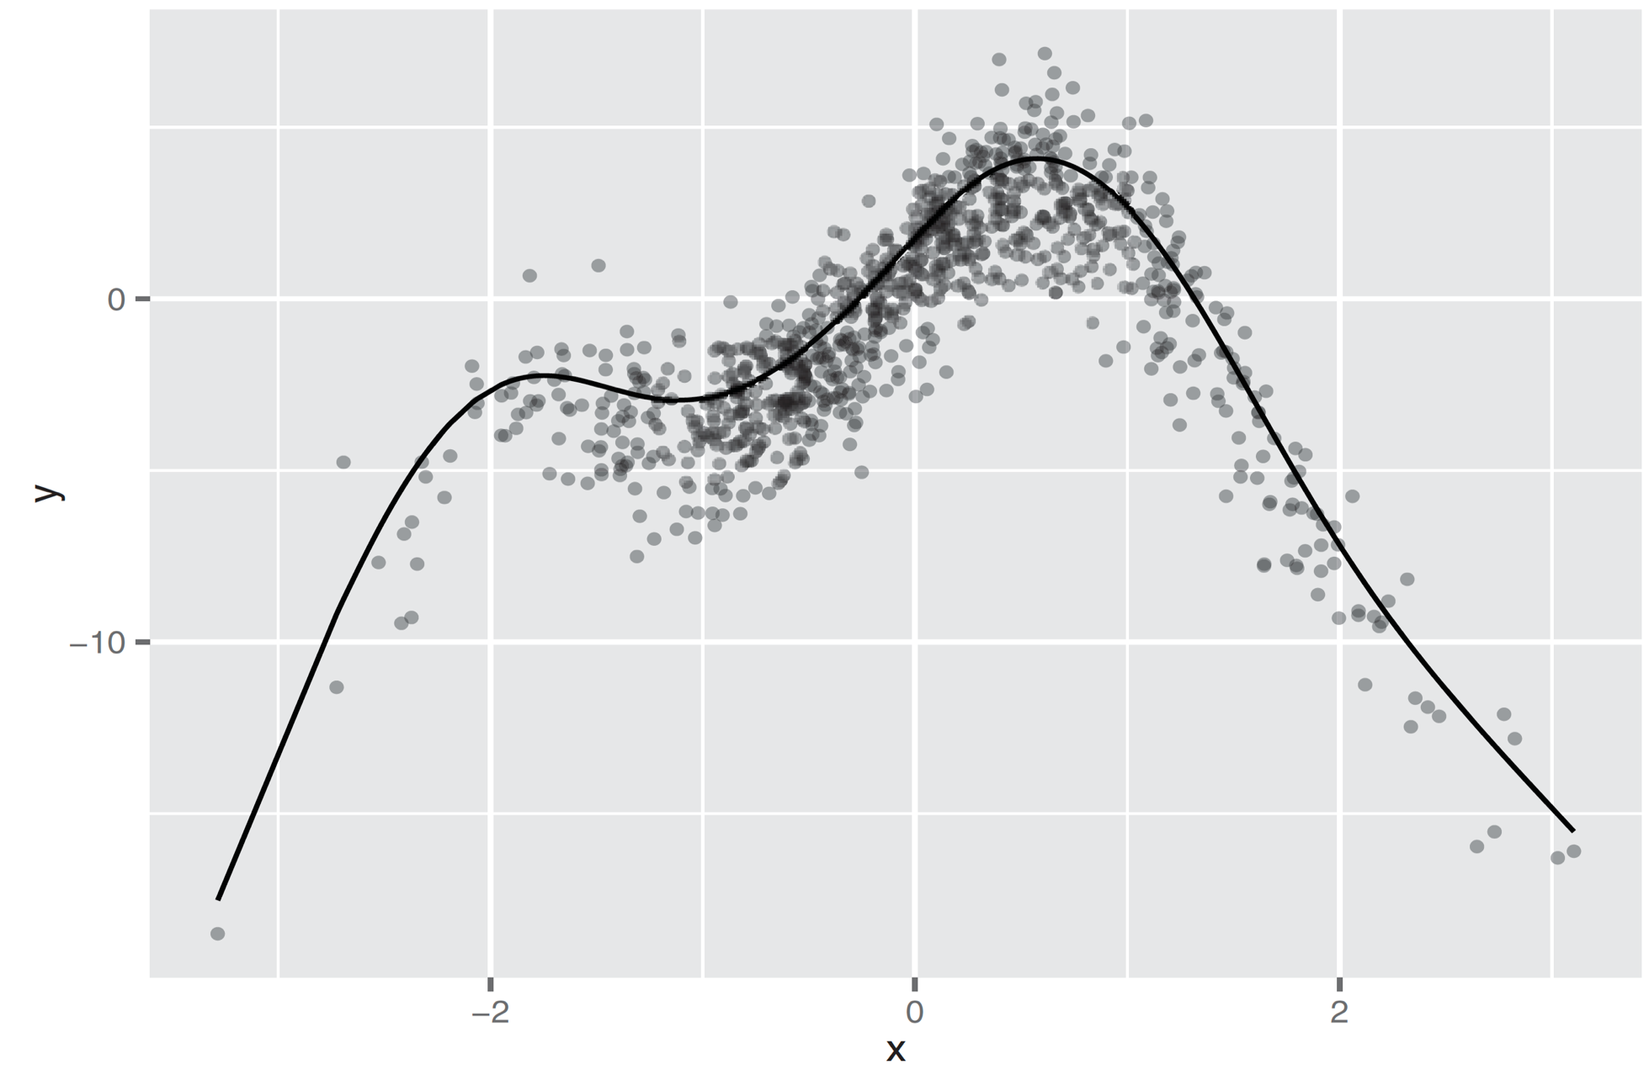
Generalized additive models (GAMs)
a way to model non-monotone responses within the framework of a linear or logistic model, relaxes the linearity constraint
f(x[i,]) = a0 + s₁(x[i,1]) + s₂(x[i,2]) + ... s_{n}(x[i,n])
Figure 9.2, Practical Data Science with R by Nina Zumel, John Mount

Slide 8
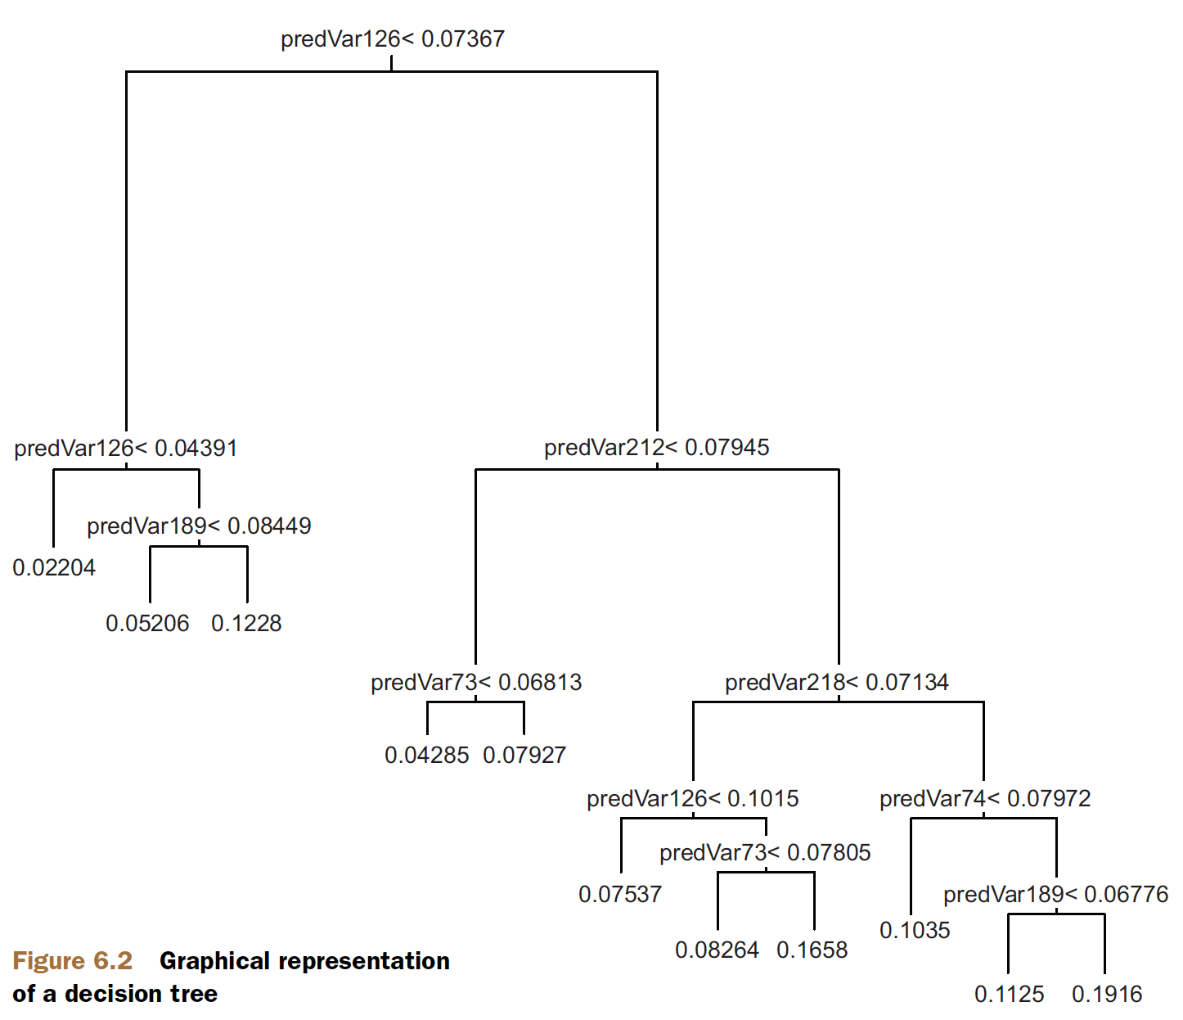
Using decision trees
a procedure to split the training data into pieces and use a simple memorized constant on each piece
Figure 6.2, Practical Data Science with R by Nina Zumel, John Mount

Slide 9
Why a bad decision tree?
possible sources of the failure
overfitting is because our model is too complicated
What we can do to work around
monkey a bit with the controls by rpart.control
cp=0.001, complexity parameter: save computing time by pruning off splits that are obviously not worthwhile. => any split which does not improve the fit by cp will likely be pruned off by cross-validation, and that hence the program need not pursue it.
Practical Data Science with R by Nina Zumel, John Mount

Slide 10
Why a bad decision tree?
What we can do to work around
monkey a bit with the controls by rpart.control
minsplit=1000, the minimum number of observations that must exist in a node in order for a split to be attempted
minbucket=1000, the minimum number of observations in any terminal <leaf> node.
If only one of minbucket or minsplit is specified, the code either sets
minsplit = minbucket*3
minbucket = minsplit/3
maxdepth=5, Set the maximum depth of any node of the final tree, with the root node counted as depth 0
Practical Data Science with R by Nina Zumel, John Mount

Slide 11
Ensemble learning

Slide 12
Using bagging to improve prediction
(random samples with replacement) from your data.
From each sample, build a decision tree model
x is an input datum, y_{i}(x) is the output of the ith tree
The final model is the average of all the individual decision trees
c(y₁(x), y₂(x), ... y_{n}(x)) is the vector of individual outputs
y is the output of the final model
Practical Data Science with R by Nina Zumel, John Mount

Slide 13
Using bagging to improve prediction
Final model
For regression, or for estimating class probabilities
y(x) is the average of the scores returned by the individual trees
y(x) = mean(c(y₁(x), ... y_{n}(x))) .
For classification
the final model assigns the class that got the most votes from the individual trees.
Bagging decision trees stabilizes the final model by lowering the variance
A bagged ensemble of trees is also less likely to overfit the data.
Practical Data Science with R by Nina Zumel, John Mount

Slide 14
Measure Bagging decision trees
The improvement is more dramatic on the test set: the bagged model has less generalization error than the single decision tree.
Generalization error is the difference in accuracy of the model on data it’s never seen before, as compared to its error on the training set.
Practical Data Science with R by Nina Zumel, John Mount

Slide 15
Using random forests to further improve prediction
Motivation
In bagging, each tree is built by considering the exact same set of features.
Hence, the individual trees will tend to be overly correlated with each other.
If there are regions in feature space where one tree tends to make mistakes, then all the trees are likely to make mistakes there.
The random forest approach tries to de-correlate the trees by randomizing the set of variables that each tree is allowed to use.
Practical Data Science with R by Nina Zumel, John Mount

Slide 16
Bagging and random forest takeaways
Bagging stabilizes decision trees and improves accuracy by reducing variance.
Bagging reduces generalization error.
Random forests further improve decision tree performance by de-correlating the individual trees in the bagging ensemble.
Practical Data Science with R by Nina Zumel, John Mount

Slide 17
Bagging and random forest takeaways
Random forests’ variable importance measures can help you determine which variables are contributing the most strongly to your model.
Because the trees in a random forest ensemble are unpruned and potentially quite deep, there’s still a danger of overfitting. => limiting how deep the trees can be grown by using the maxnodes parameter in randomForest()
Be sure to evaluate the model on holdout data to get a better estimate of model performance.
Practical Data Science with R by Nina Zumel, John Mount

Slide 18
Today
Chp 9.3 Using kernel methods to increase data separation
Chp 9.4 Using SVMs to model complicated decision boundaries
Chp 9. Support Vector Machine

Slide 19
Maximal Margin Classifier

Slide 20
Hyperplane
In a p-dimensional space, a hyperplane is a flat affine subspace of dimension p − 1
in two dimensions, a hyperplane is a flat one-dimensional subspace — a line
in three dimensions, a hyperplane is a flat two-dimensional subspace — a plane
An Introduction to Statistical Learning with Applications in R by Gareth James, Daniela Witten, Trevor Hastie, Robert Tibshirani

Slide 21
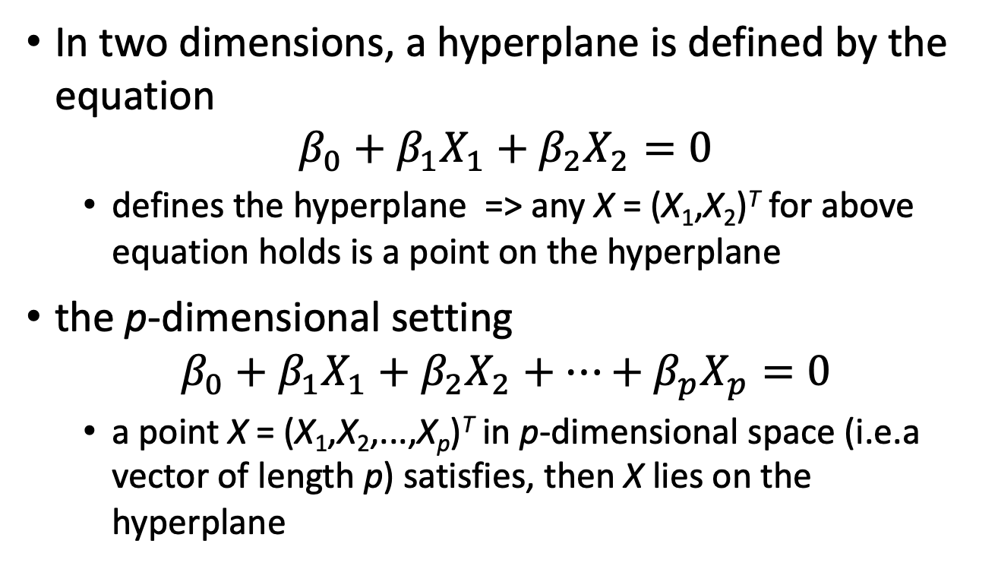
Hyperplane
In two dimensions, a hyperplane is defined by the equation
$$β_{0}+β_{1}X_{1}+β_{2}X_{2}=0$$
defines the hyperplane => any X = (X₁,X₂)^{T} for above equation holds is a point on the hyperplane
the p-dimensional setting
$$β_{0}+β_{1}X_{1}+β_{2}X_{2}+…+β_{p}X_{p}=0$$
a point X = (X₁,X₂,...,X_{p})^{T} in p-dimensional space (i.e.a vector of length p) satisfies, then X lies on the hyperplane
An Introduction to Statistical Learning with Applications in R by Gareth James, Daniela Witten, Trevor Hastie, Robert Tibshirani

Slide 22
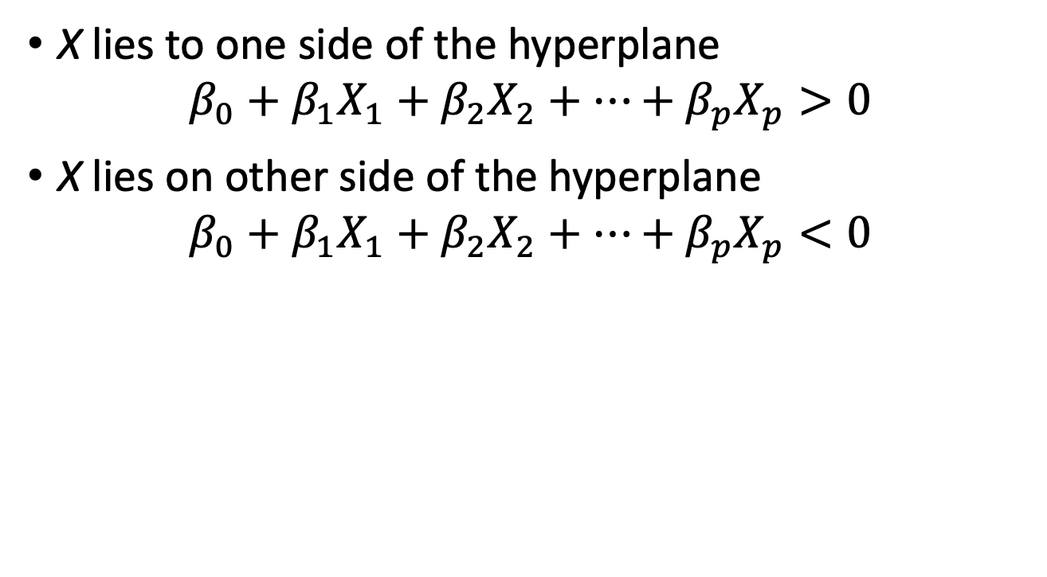
Hyperplane
X lies to one side of the hyperplane
$$β_{0}+β_{1}X_{1}+β_{2}X_{2}+…+β_{p}X_{p}>0$$
X lies on other side of the hyperplane
$$β_{0}+β_{1}X_{1}+β_{2}X_{2}+…+β_{p}X_{p}<0$$
An Introduction to Statistical Learning with Applications in R by Gareth James, Daniela Witten, Trevor Hastie, Robert Tibshirani

Slide 23
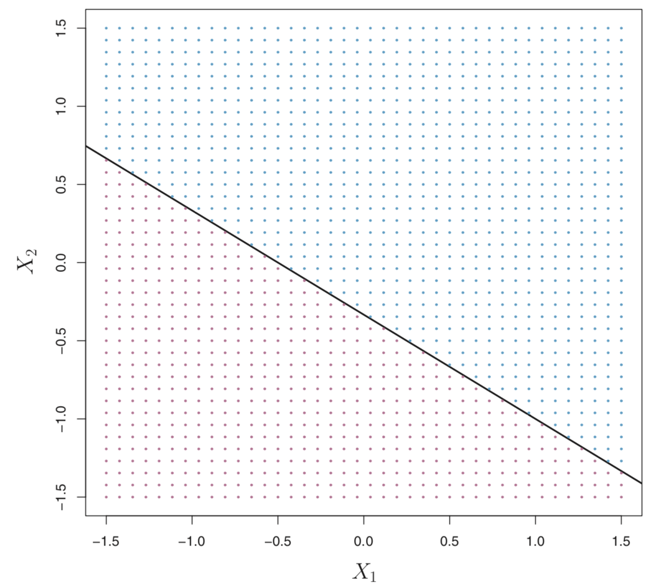
1 + 2X₁ + 3X₂ = 0
Figure 9.1, An Introduction to Statistical Learning with Applications in R by Gareth James, Daniela Witten, Trevor Hastie, Robert Tibshirani

Slide 24
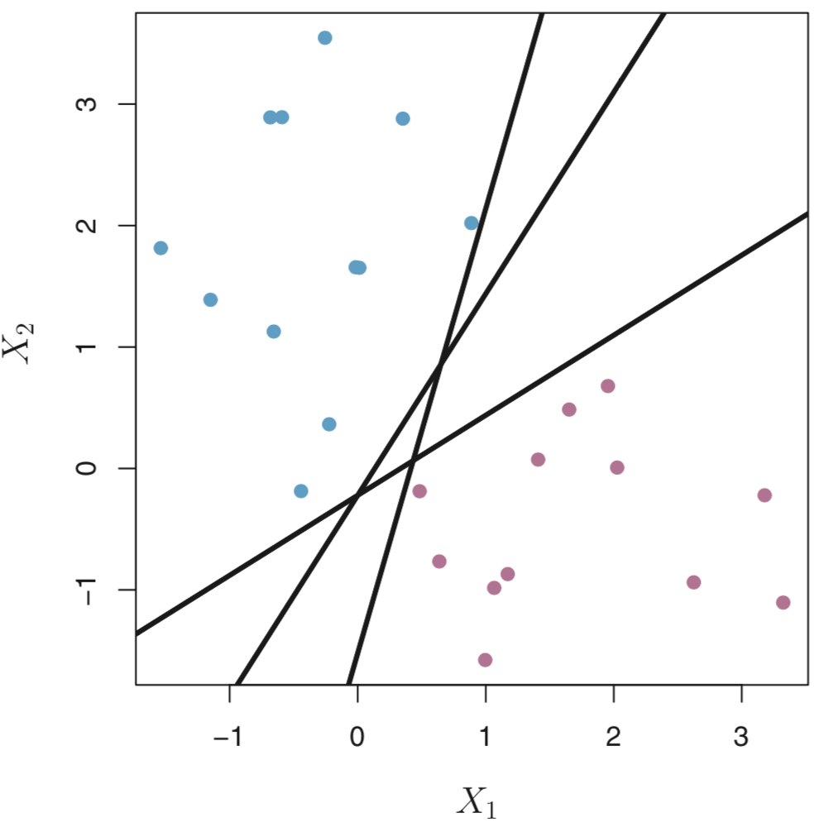
Separating hyperplane
n×p data matrix X that consists of
n training observations in p-dimensional space, x₁,…,x_{n}
in two classes: y₁ , . . . , y_{n} ∈ {−1, 1}
−1 represents one class
1 the other class
Figure 9.2, An Introduction to Statistical Learning with Applications in R by Gareth James, Daniela Witten, Trevor Hastie, Robert Tibshirani

Slide 25
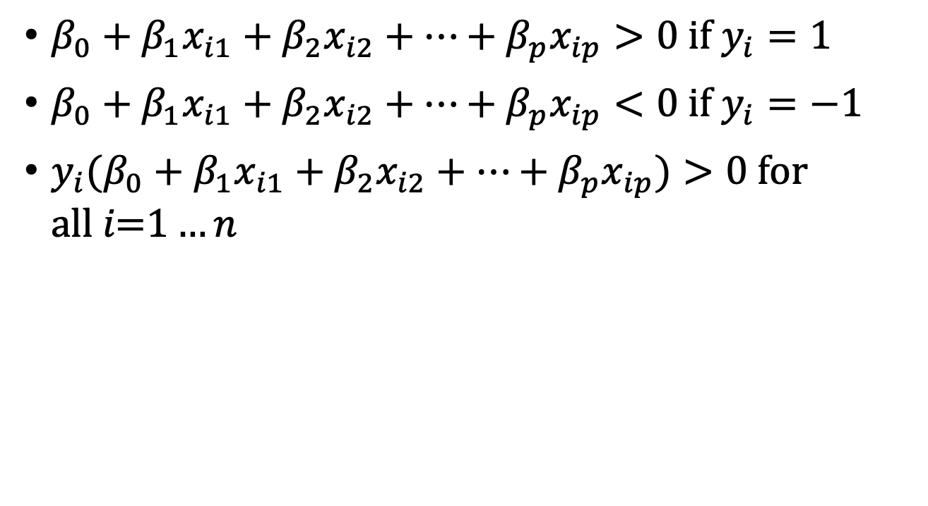
Separating hyperplane
$β_{0}+β_{1}x_{i1}+β_{2}x_{i2}+…+β_{p}x_{ip}>0 if y_{i}=1$
$β_{0}+β_{1}x_{i1}+β_{2}x_{i2}+…+β_{p}x_{ip}<0 if y_{i}=−1$
${y_{i}(β}_{0}+β_{1}x_{i1}+β_{2}x_{i2}+…+β_{p}x_{ip})>0 \text{for} \text{all} i\text{=1}…n$
An Introduction to Statistical Learning with Applications in R by Gareth James, Daniela Witten, Trevor Hastie, Robert Tibshirani

Slide 26
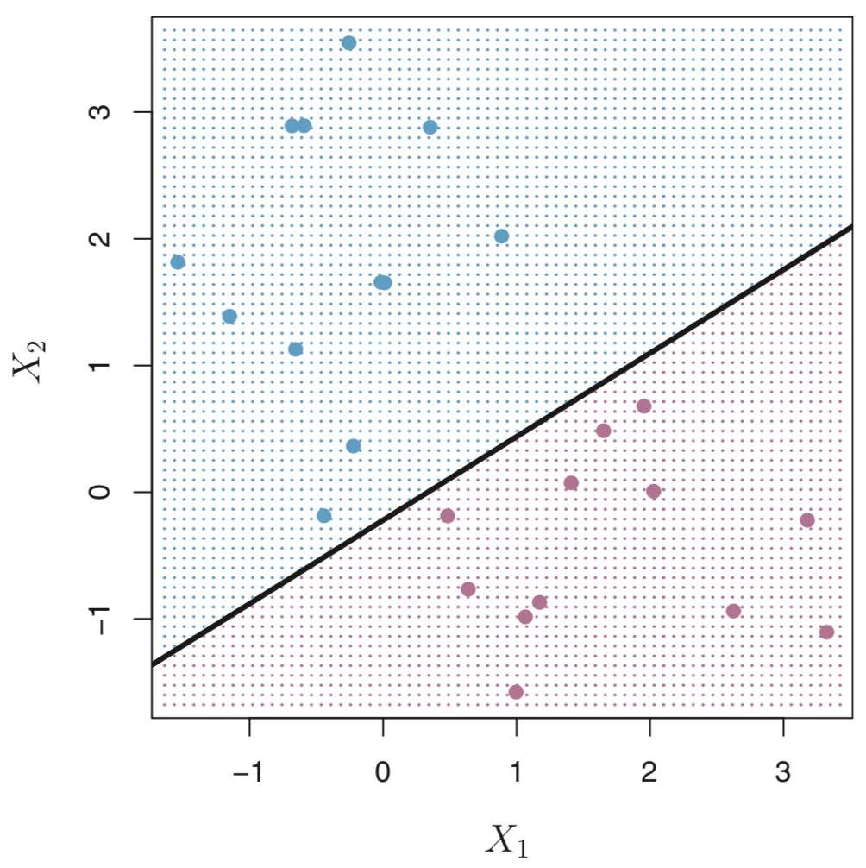
Separating hyperplane
Figure 9.2, An Introduction to Statistical Learning with Applications in R by Gareth James, Daniela Witten, Trevor Hastie, Robert Tibshirani

Slide 27
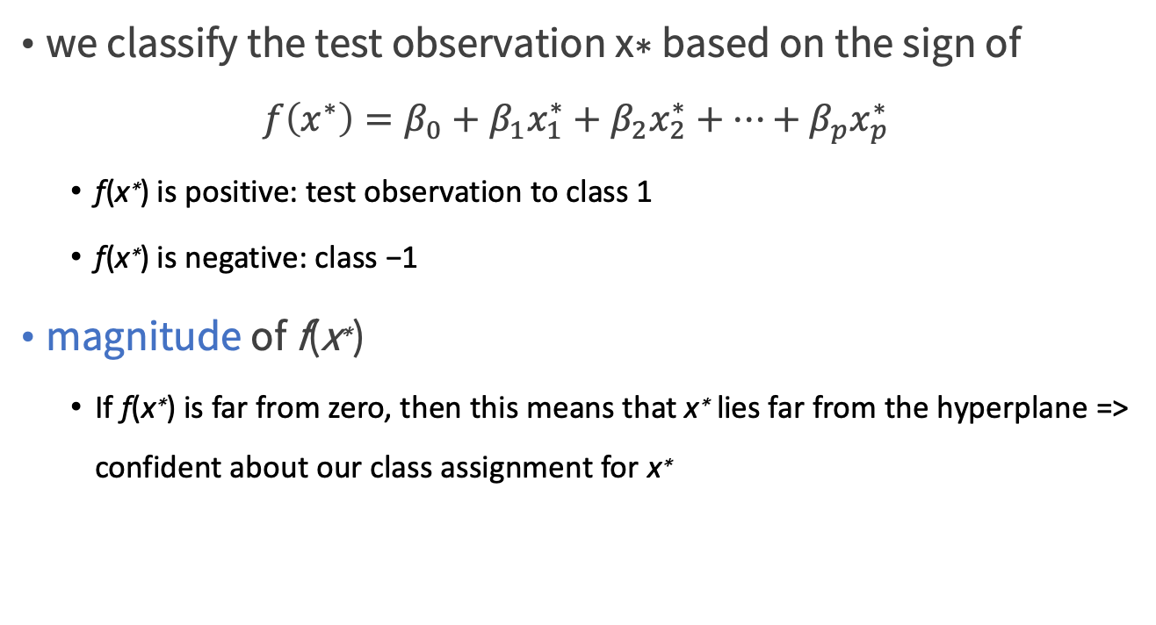
Separating hyperplane
we classify the test observation x∗ based on the sign of
$$f\left(x^{∗}\right)=β_{0}+β_{1}x_{1}^{∗}+β_{2}x_{2}^{∗}+…+β_{p}x_{p}^{∗}$$
f(x∗) is positive: test observation to class 1
f(x∗) is negative: class −1
magnitude of f(x∗)
If f(x∗) is far from zero, then this means that x∗ lies far from the hyperplane => confident about our class assignment for x∗
An Introduction to Statistical Learning with Applications in R by Gareth James, Daniela Witten, Trevor Hastie, Robert Tibshirani

Slide 28
Margin
the minimal distance from the observations to the hyperplane
Figure 9.2, An Introduction to Statistical Learning with Applications in R by Gareth James, Daniela Witten, Trevor Hastie, Robert Tibshirani

Slide 29
Maximal Margin Classifier (optimal separating hyperplane)
if our data can be perfectly separated using a hyperplane, then there will in fact exist an infinite number of such hyperplanes
The maximal margin hyperplane is the separating hyperplane for which the margin is largest
the maximal margin classifier: classify a test observation based on which side of the maximal margin hyperplane it lies
An Introduction to Statistical Learning with Applications in R by Gareth James, Daniela Witten, Trevor Hastie, Robert Tibshirani

Slide 30

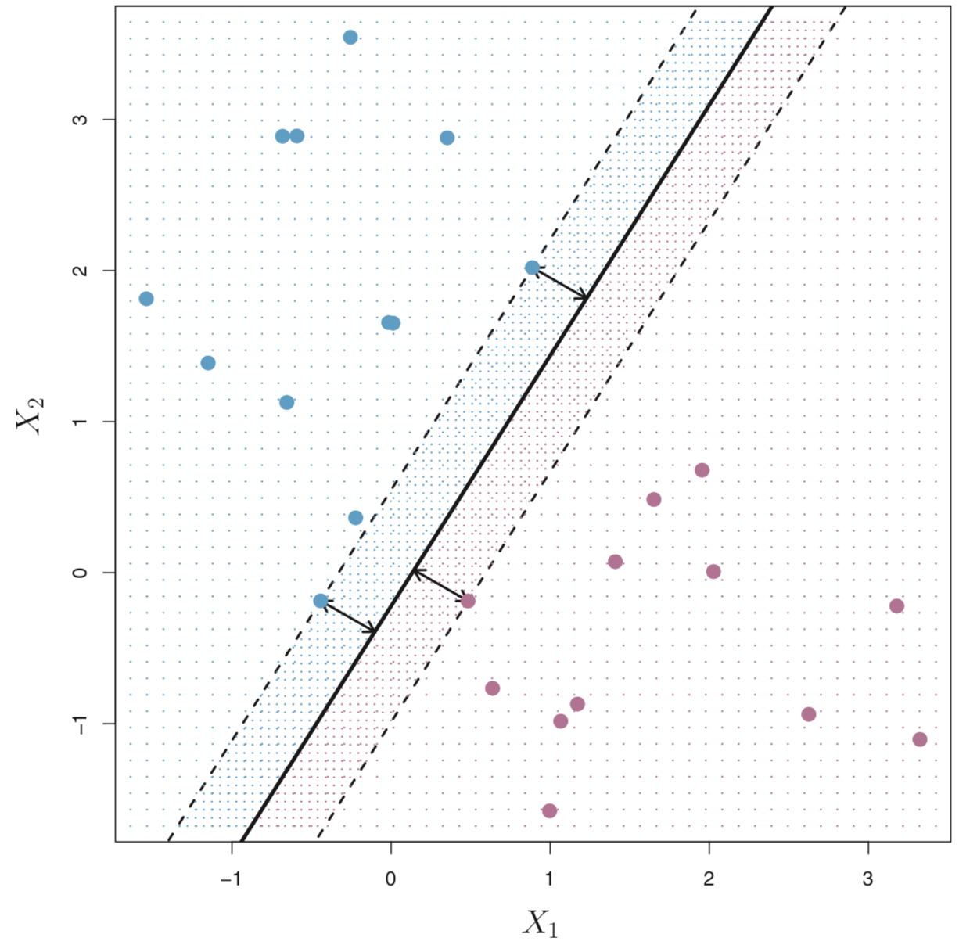
Figure 9.2、9.3, An Introduction to Statistical Learning with Applications in R by Gareth James, Daniela Witten, Trevor Hastie, Robert Tibshirani

Slide 31
Support vectors
three training observations are equidistant from the maximal margin hyperplane and lie along the dashed lines indicating the width of the margin
They are vectors in p-dimensional space
They support the maximal margin hyperplane
if these points were moved slightly then the maximal margin hyperplane would move as well
a movement to any of the other observations would not affect the separating hyperplane
An Introduction to Statistical Learning with Applications in R by Gareth James, Daniela Witten, Trevor Hastie, Robert Tibshirani

Slide 32
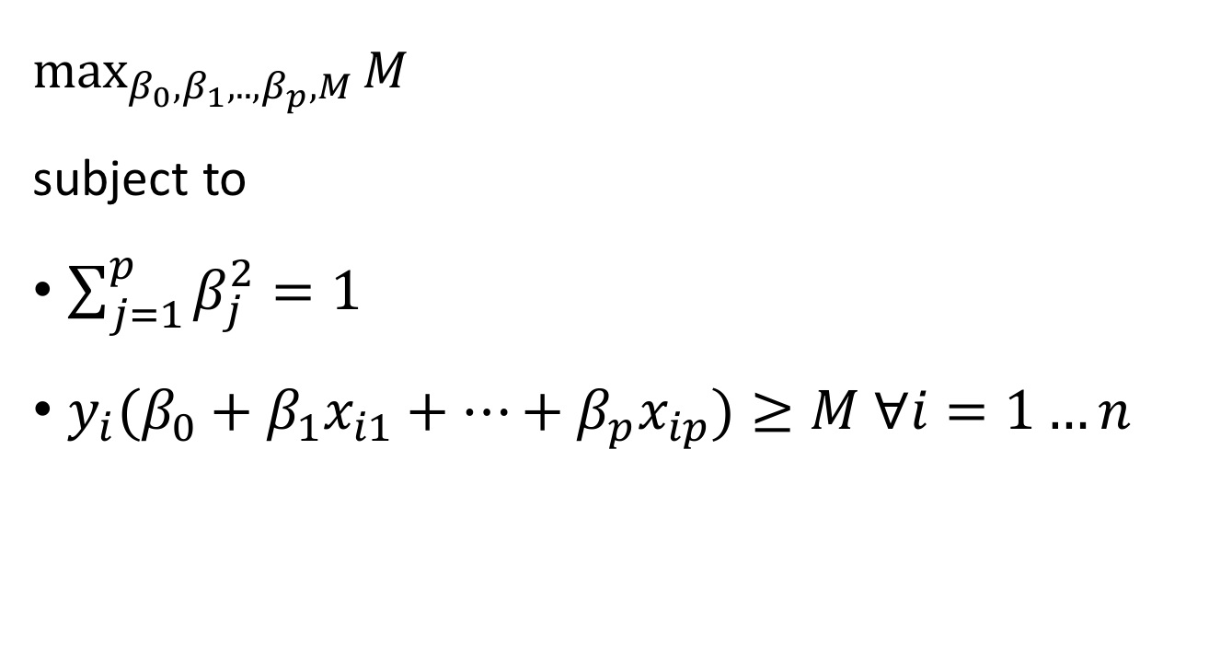
Construction of the Maximal Margin Classifier
$\max_{β_{0},β_{1},..,β_{p},M}{M}$
subject to
$\sum_{j=1}^{p}{β_{j}^{2}=1}$
${y_{i}(β}_{0}+β_{1}x_{i1}+…+β_{p}x_{ip})≥M ∀i=1…n$
An Introduction to Statistical Learning with Applications in R by Gareth James, Daniela Witten, Trevor Hastie, Robert Tibshirani

Slide 33
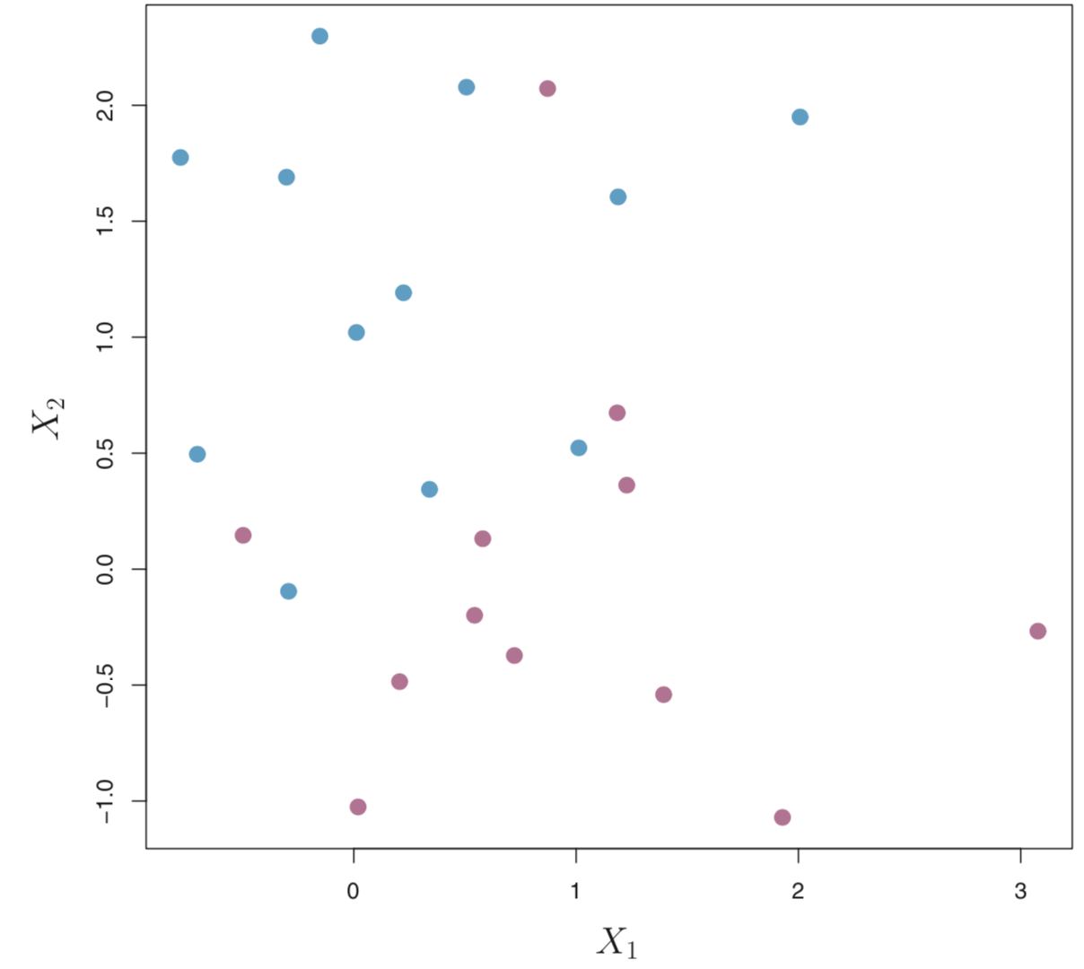
The Non-separable Case
The maximal margin classifier is a very natural way to perform classification, if a separating hyperplane exists.
Figure 9.4, An Introduction to Statistical Learning with Applications in R by Gareth James, Daniela Witten, Trevor Hastie, Robert Tibshirani

Slide 34
Support Vector Classifiers

Slide 35
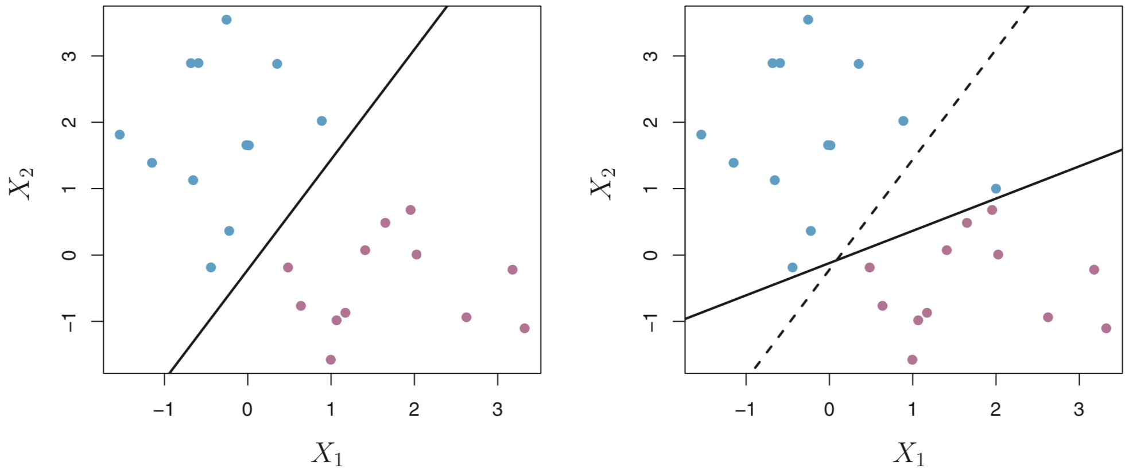
The addition of a single observation in the right-hand panel leads to a dramatic change in the maximal margin hyperplane
Figure 9.5, An Introduction to Statistical Learning with Applications in R by Gareth James, Daniela Witten, Trevor Hastie, Robert Tibshirani

Slide 36
Support vector classifier (soft margin classifier)
We might be willing to consider a classifier based on a hyperplane that does not perfectly separate the two classes, in the interest of
Greater robustness to individual observations
Better classification of most of the training observations
The margin is soft because it can be violated by some of the training observations
An Introduction to Statistical Learning with Applications in R by Gareth James, Daniela Witten, Trevor Hastie, Robert Tibshirani

Slide 37
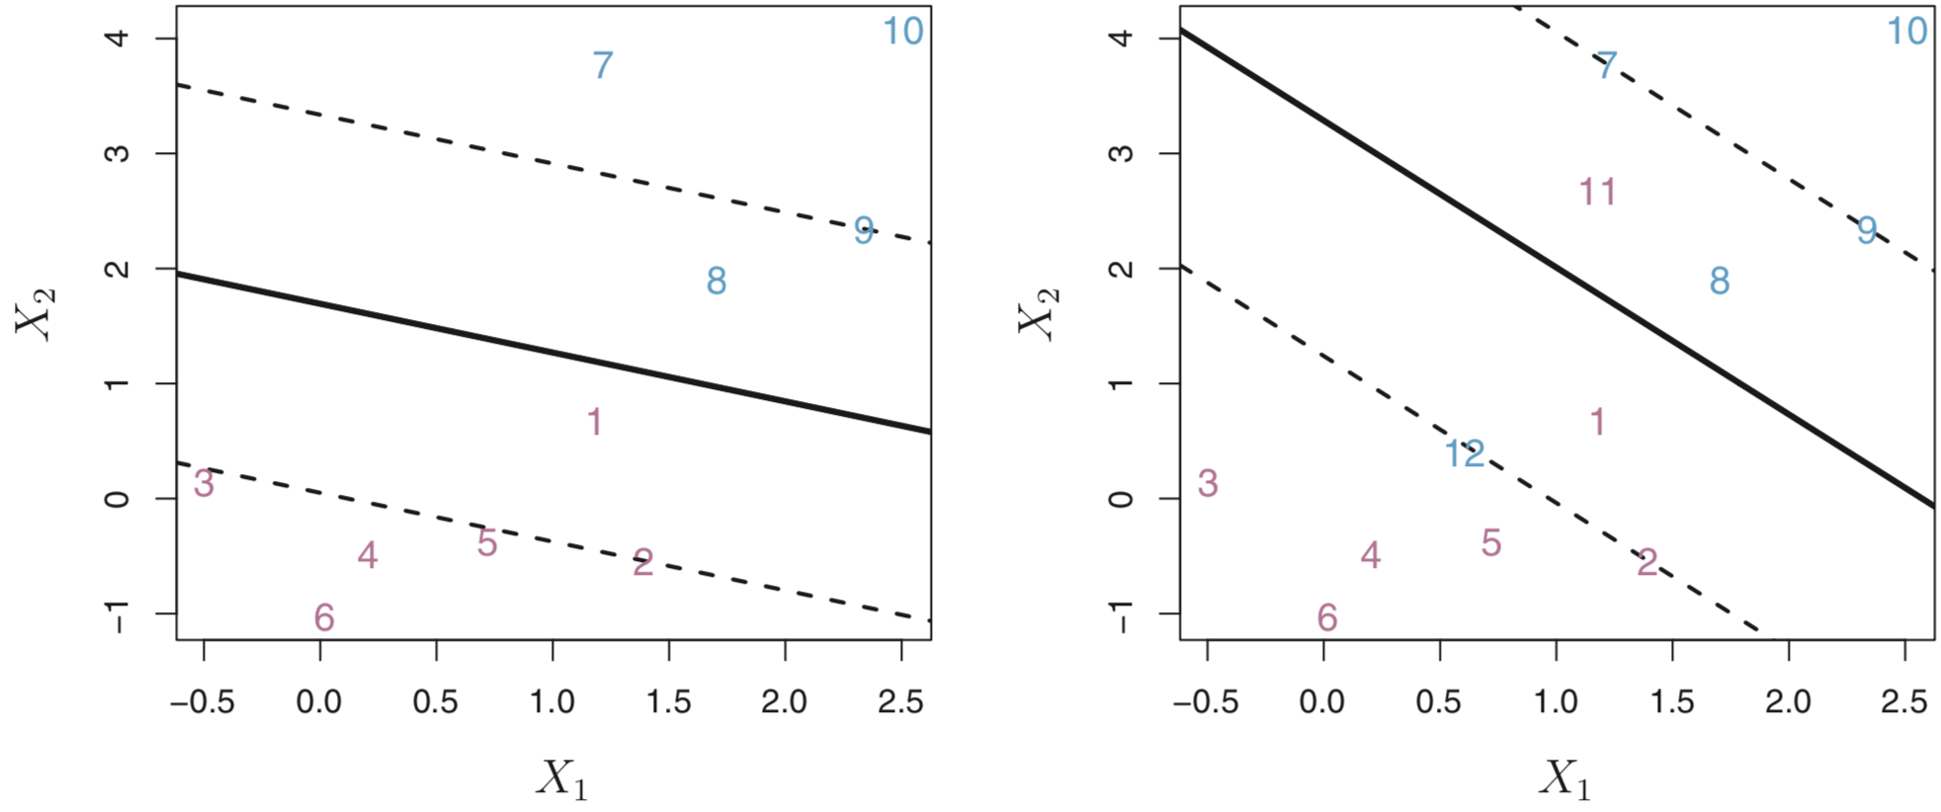
A support vector classifier was fit to a small data set
Figure 9.6, An Introduction to Statistical Learning with Applications in R by Gareth James, Daniela Witten, Trevor Hastie, Robert Tibshirani

Slide 38
Soft margin
soft margin : adds additional error terms that are used to allow a limited fraction of the training examples to be on the wrong side of the decision surface
C : a control that determines the trade-off between
margin width for the remaining data
how much data is pushed around to achieve the margin
higher than 1 increases the penalty for moving data

Slide 39
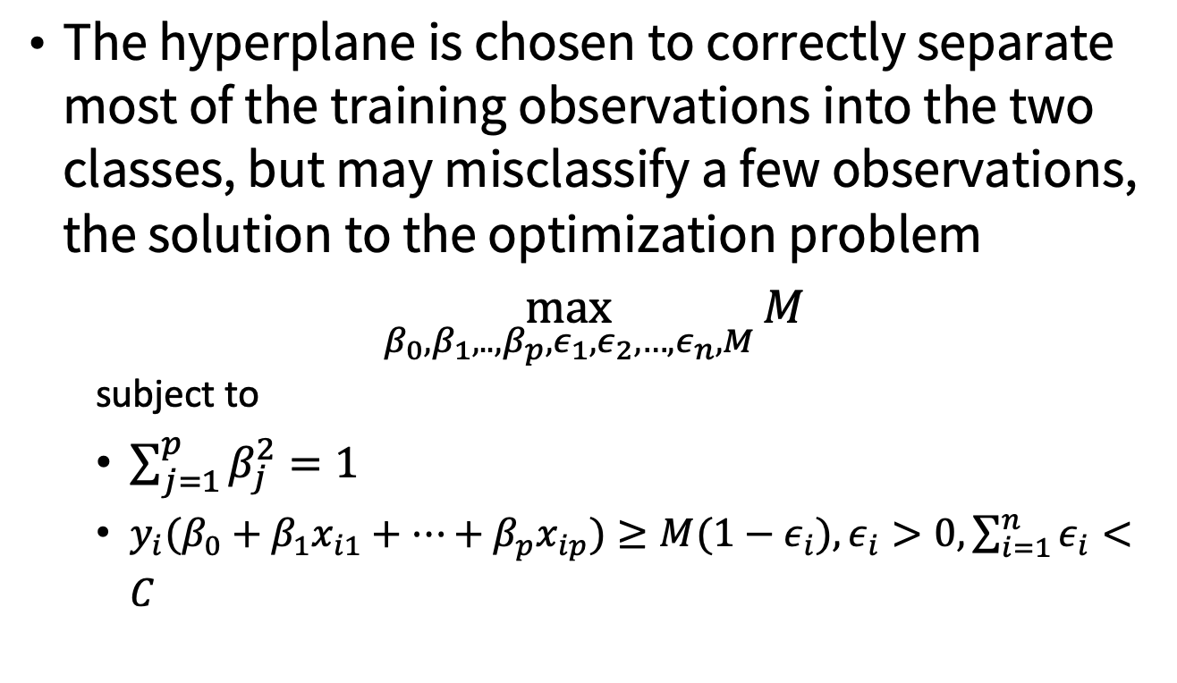
Support Vector Classifier
The hyperplane is chosen to correctly separate most of the training observations into the two classes, but may misclassify a few observations, the solution to the optimization problem
$\max_{β_{0},β_{1},..,β_{p},ε_{1},ε_{2},…,ε_{n},M}{M}$
subject to
$\sum_{j=1}^{p}{β_{j}^{2}=1}$
${y_{i}(β}_{0}+β_{1}x_{i1}+…+β_{p}x_{ip})≥M(1−ε_{i}),ε_{i}>0,\sum_{i=1}^{n}{ε_{i}}<C$
An Introduction to Statistical Learning with Applications in R by Gareth James, Daniela Witten, Trevor Hastie, Robert Tibshirani

Slide 40
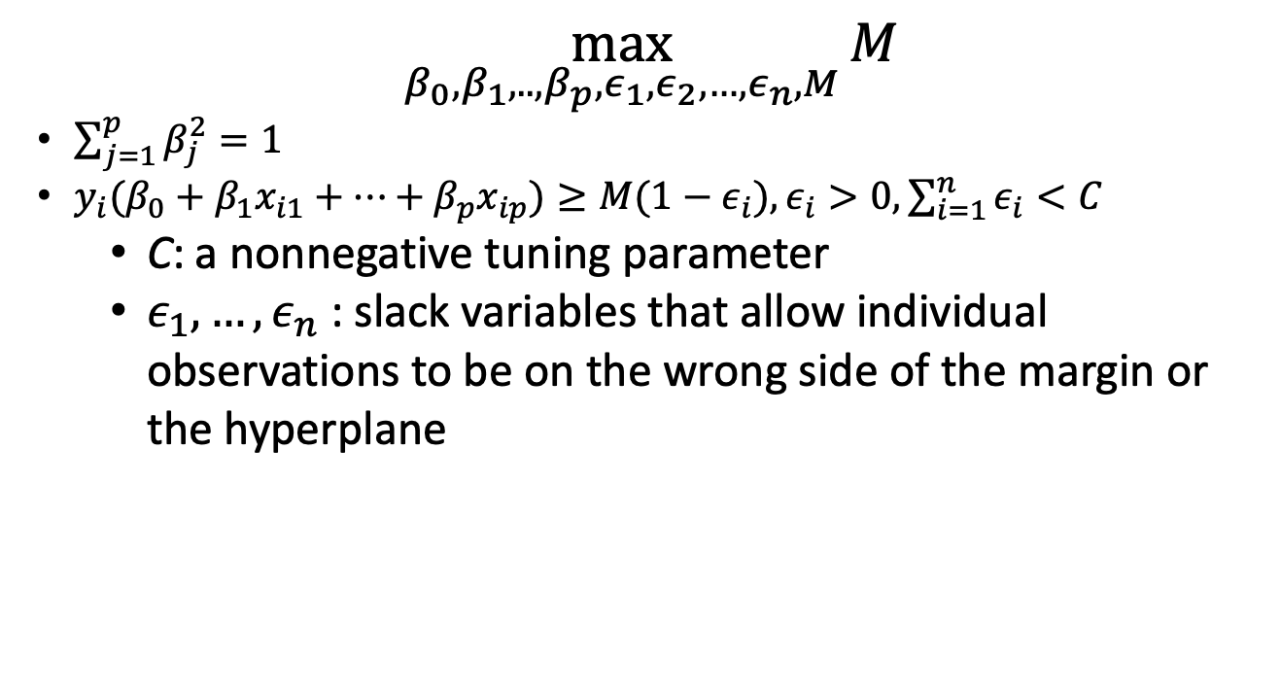
Support Vector Classifier
$\max_{β_{0},β_{1},..,β_{p},ε_{1},ε_{2},…,ε_{n},M}{M}$
$\sum_{j=1}^{p}{β_{j}^{2}=1}$
${y_{i}(β}_{0}+β_{1}x_{i1}+…+β_{p}x_{ip})≥M(1−ε_{i}),ε_{i}>0,\sum_{i=1}^{n}{ε_{i}}<C$
C: a nonnegative tuning parameter
$ε_{1},…,ε_{n}$ : slack variables that allow individual observations to be on the wrong side of the margin or the hyperplane
An Introduction to Statistical Learning with Applications in R by Gareth James, Daniela Witten, Trevor Hastie, Robert Tibshirani

Slide 41
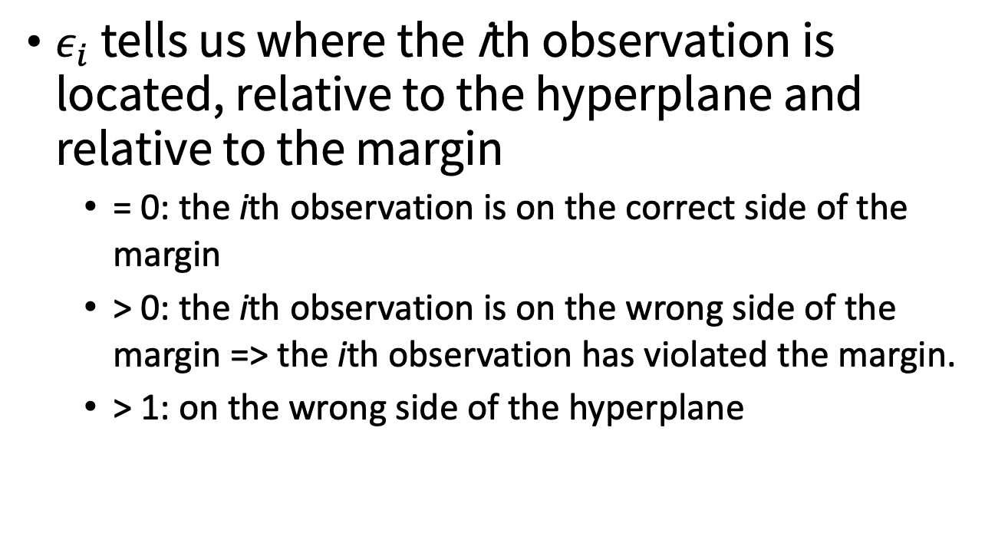
Slack variable
$ε_{i}$ tells us where the ith observation is located, relative to the hyperplane and relative to the margin
= 0: the ith observation is on the correct side of the margin
> 0: the ith observation is on the wrong side of the margin => the ith observation has violated the margin.
> 1: on the wrong side of the hyperplane

Slide 42
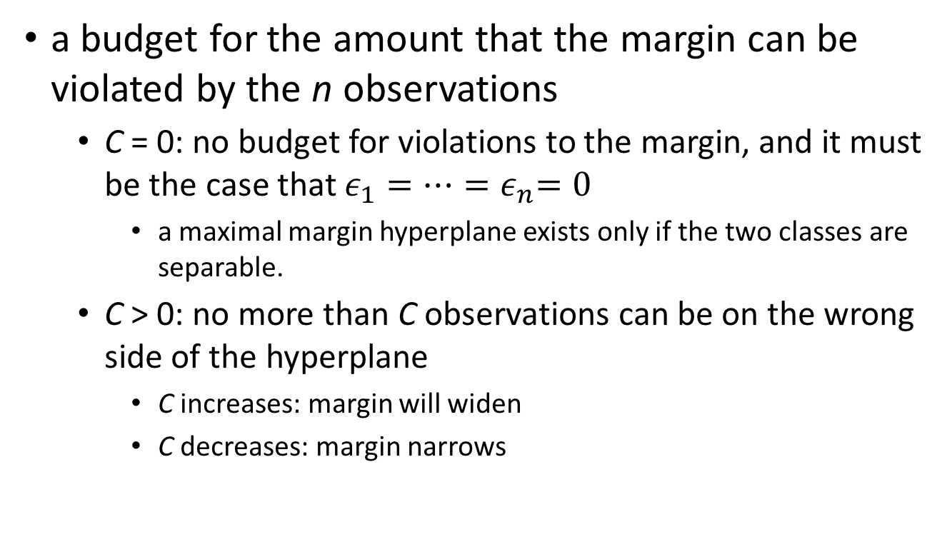
A nonnegative tuning parameter C
a budget for the amount that the margin can be violated by the n observations
C = 0: no budget for violations to the margin, and it must be the case that $ε_{1}=…{=ε}_{n}=0$
a maximal margin hyperplane exists only if the two classes are separable.
C > 0: no more than C observations can be on the wrong side of the hyperplane
C increases: margin will widen
C decreases: margin narrows
An Introduction to Statistical Learning with Applications in R by Gareth James, Daniela Witten, Trevor Hastie, Robert Tibshirani

Slide 43
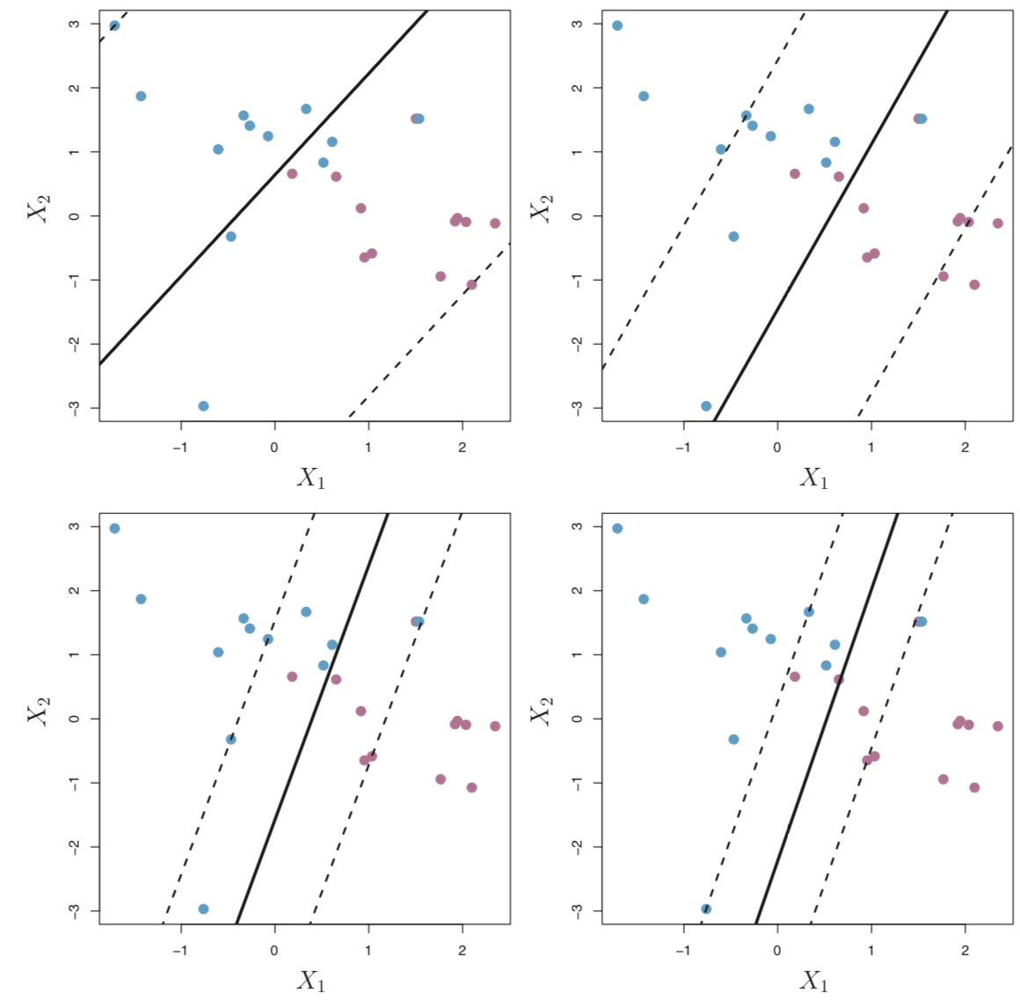
C controls the bias-variance trade-off
more biased but may have lower variance
low bias but high variance
Figure 9.7, An Introduction to Statistical Learning with Applications in R by Gareth James, Daniela Witten, Trevor Hastie, Robert Tibshirani

Slide 44
Support vectors
only observations that either lie on the margin or that violate the margin will affect the hyperplane, and hence the classifier obtained
C is large: the margin is wide => many observations violate the margin, and so there are many support vectors => this classifier has low variance but potentially high bias
C is small: fewer support vectors => the resulting classifier will have low bias but high variance
An Introduction to Statistical Learning with Applications in R by Gareth James, Daniela Witten, Trevor Hastie, Robert Tibshirani

Slide 45
support vector classifier’s decision rule is based only on a potentially small subset of the training observations (the support vectors) means that it is quite robust to the behavior of observations that are far away from the hyperplane.
This property is distinct from some of the other classification methods
An Introduction to Statistical Learning with Applications in R by Gareth James, Daniela Witten, Trevor Hastie, Robert Tibshirani

Slide 46
Kernel Method

Slide 47
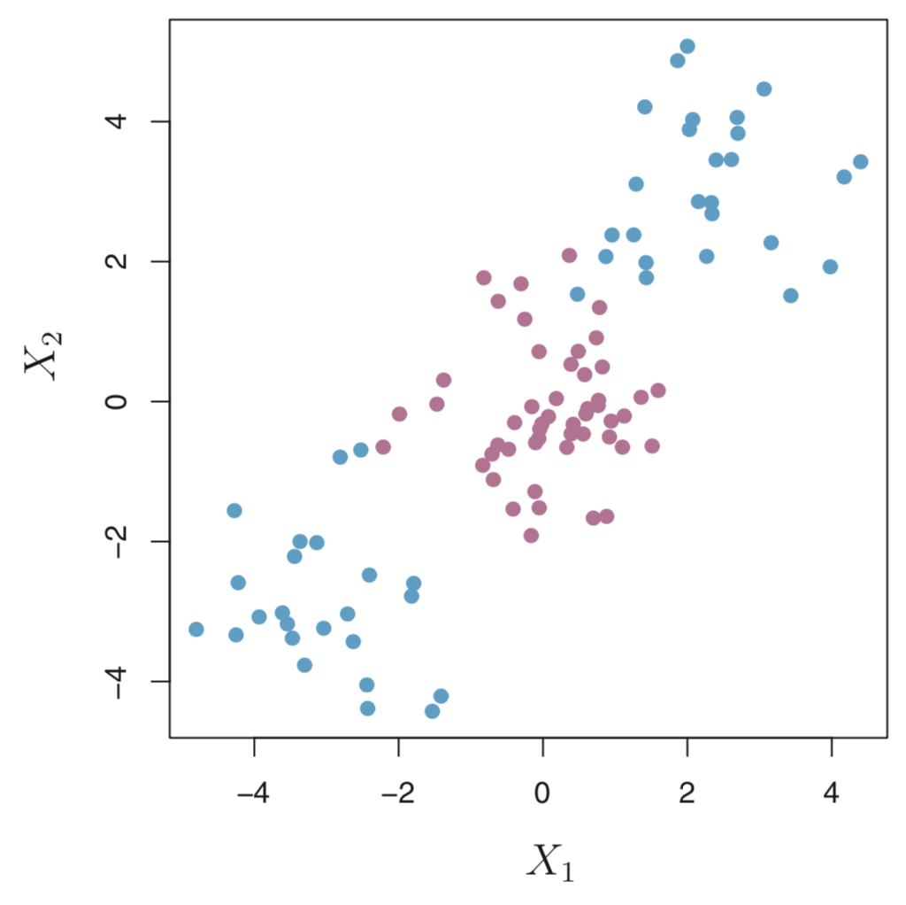
Classification with Non-linear Decision Boundaries
The support vector classifier is a natural approach for classification in the two-class setting, if the boundary between the two classes is linear.
Figure 9.8, An Introduction to Statistical Learning with Applications in R by Gareth James, Daniela Witten, Trevor Hastie, Robert Tibshirani

Slide 48
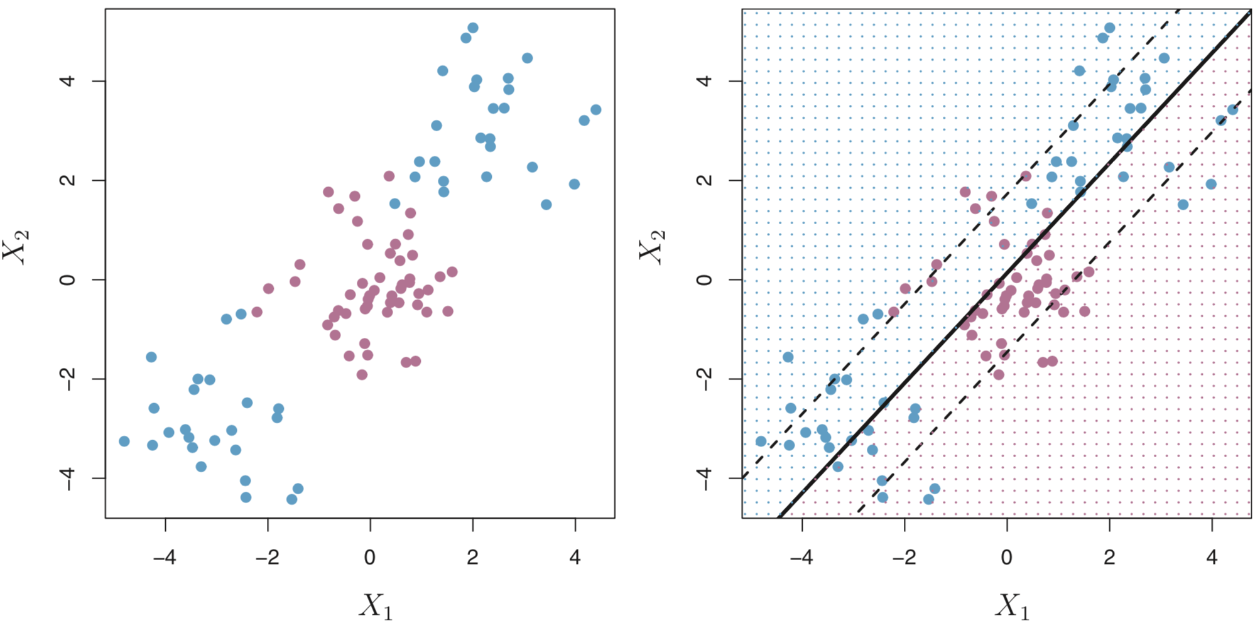
Classification with Non-linear Decision Boundaries
Figure 9.8, An Introduction to Statistical Learning with Applications in R by Gareth James, Daniela Witten, Trevor Hastie, Robert Tibshirani

Slide 49
Using kernel methods to increase data separation
synthetic : create new variables from combinations of the measurements you already have at hand
one way to produce new variables from old and to increase the power of machine learning methods
points from different classes are mixed together can often be lifted to a space
points from each class are grouped together
separated from out-of-class points

Slide 50
Classification with Non-linear Decision Boundaries
support vector classifier using p features
X₁, X₂, …, X_{p}
support vector classifier using 2p features
X₁, X₁², X₂, X₂²,…, X_{p}, X_{p}²
An Introduction to Statistical Learning with Applications in R by Gareth James, Daniela Witten, Trevor Hastie, Robert Tibshirani

Slide 51
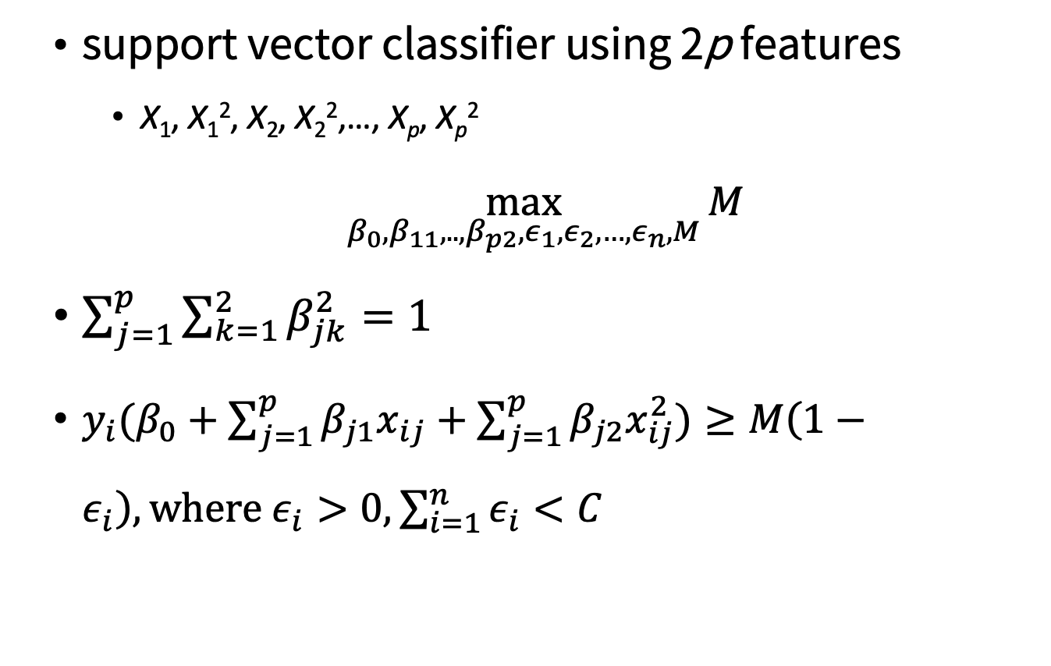
Classification with Non-linear Decision Boundaries
support vector classifier using 2p features
X₁, X₁², X₂, X₂²,…, X_{p}, X_{p}²
$\max_{β_{0},β_{11},..,β_{p2},ε_{1},ε_{2},…,ε_{n},M}{M}$
$\sum_{j=1}^{p}{\sum_{k=1}^{2}{β_{jk}^{2}}=1}$
${y_{i}(β}_{0}+\sum_{j=1}^{p}{β_{j1}x_{ij}}+\sum_{j=1}^{p}{β_{j2}x_{ij}^{2}})≥M\left(1−ε_{i}\right),\text{where} ε_{i}>0,\sum_{i=1}^{n}{ε_{i}}<C$
An Introduction to Statistical Learning with Applications in R by Gareth James, Daniela Witten, Trevor Hastie, Robert Tibshirani

Slide 52
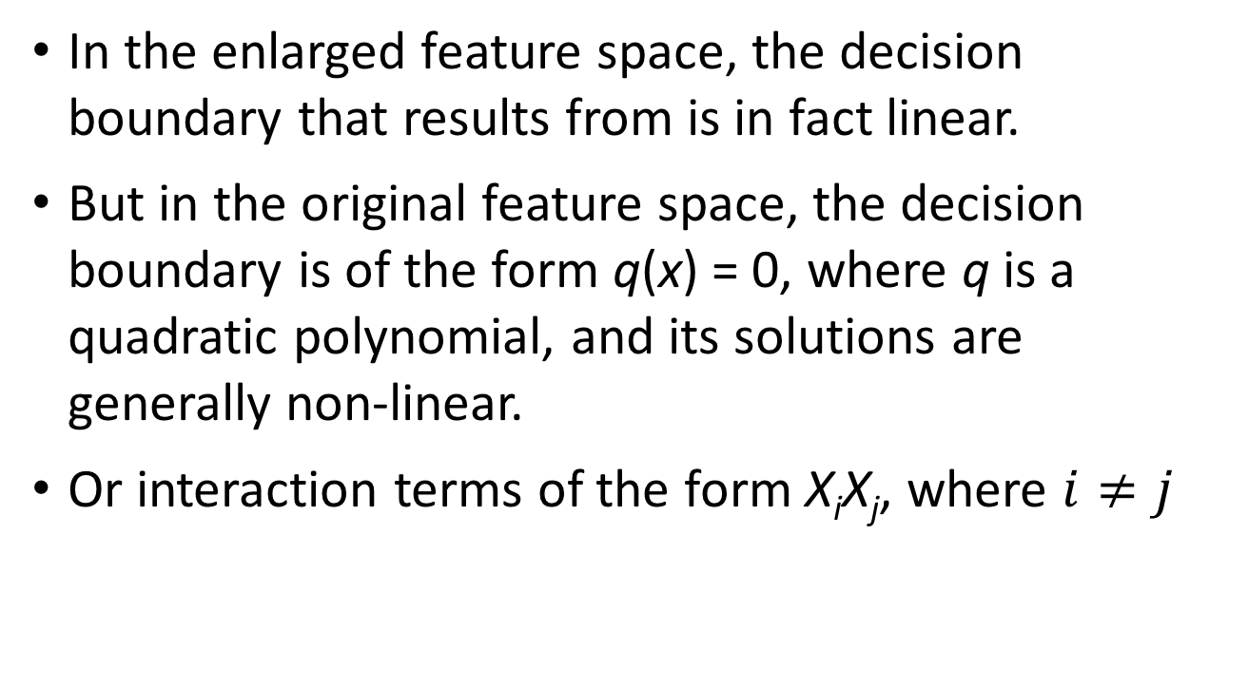
Why does this lead to a non-linear decision boundary?
In the enlarged feature space, the decision boundary that results from is in fact linear.
But in the original feature space, the decision boundary is of the form q(x) = 0, where q is a quadratic polynomial, and its solutions are generally non-linear.
Or interaction terms of the form X_{i}X_{j}, where $i≠j$
An Introduction to Statistical Learning with Applications in R by Gareth James, Daniela Witten, Trevor Hastie, Robert Tibshirani

Slide 53
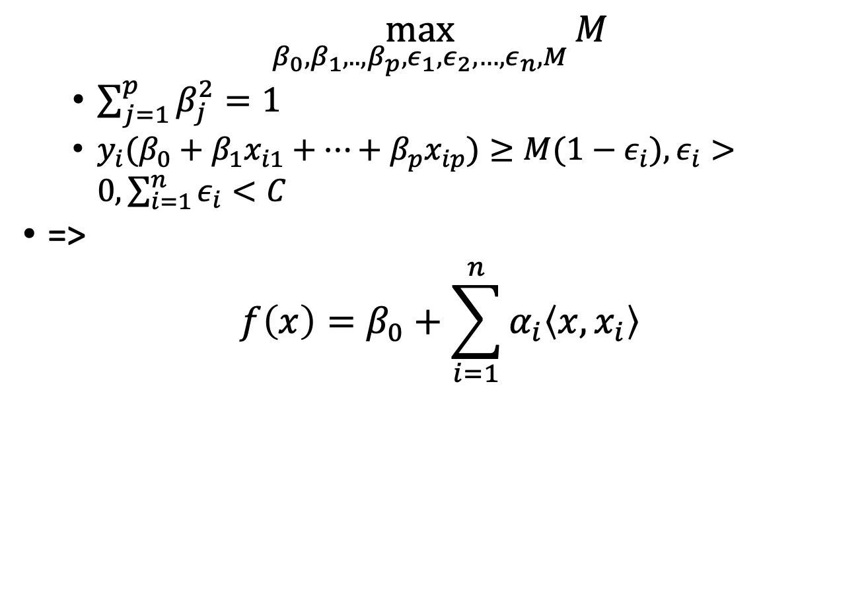
Support Vector Classifier
$\max_{β_{0},β_{1},..,β_{p},ε_{1},ε_{2},…,ε_{n},M}{M}$
$\sum_{j=1}^{p}{β_{j}^{2}=1}$
${y_{i}(β}_{0}+β_{1}x_{i1}+…+β_{p}x_{ip})≥M(1−ε_{i}),ε_{i}>0,\sum_{i=1}^{n}{ε_{i}}<C$
=>
$$f\left(x\right)=β_{0}+\sum_{i=1}^{n}{α_{i}\left\langle x,x_{i}\right\rangle }$$
An Introduction to Statistical Learning with Applications in R by Gareth James, Daniela Witten, Trevor Hastie, Robert Tibshirani

Slide 54
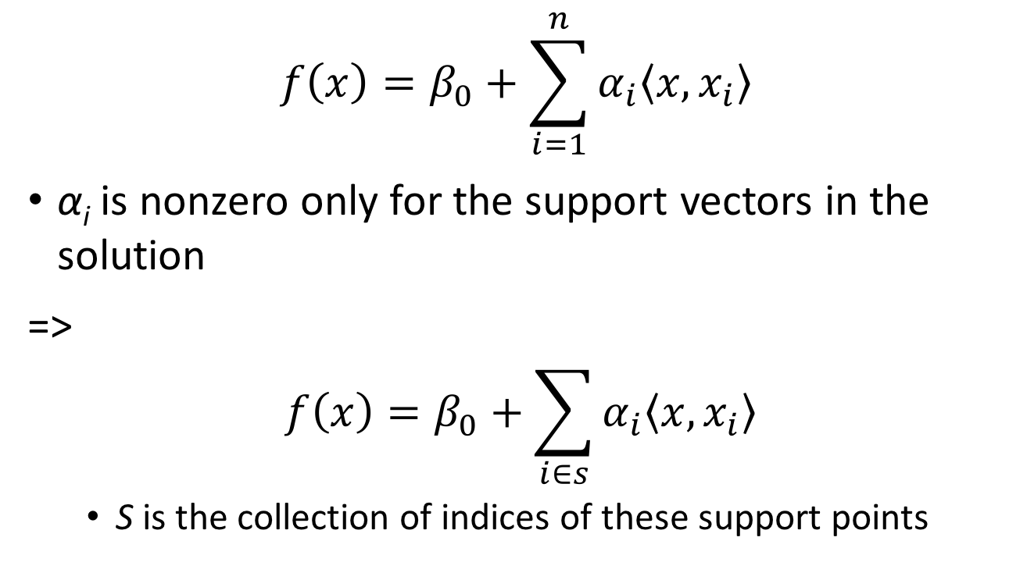
Support Vector Classifier
$$f\left(x\right)=β_{0}+\sum_{i=1}^{n}{α_{i}\left\langle x,x_{i}\right\rangle }$$
α_{i} is nonzero only for the support vectors in the solution
=>
$$f\left(x\right)=β_{0}+\sum_{i∈s}{α_{i}\left\langle x,x_{i}\right\rangle }$$
S is the collection of indices of these support points
An Introduction to Statistical Learning with Applications in R by Gareth James, Daniela Witten, Trevor Hastie, Robert Tibshirani

Slide 55
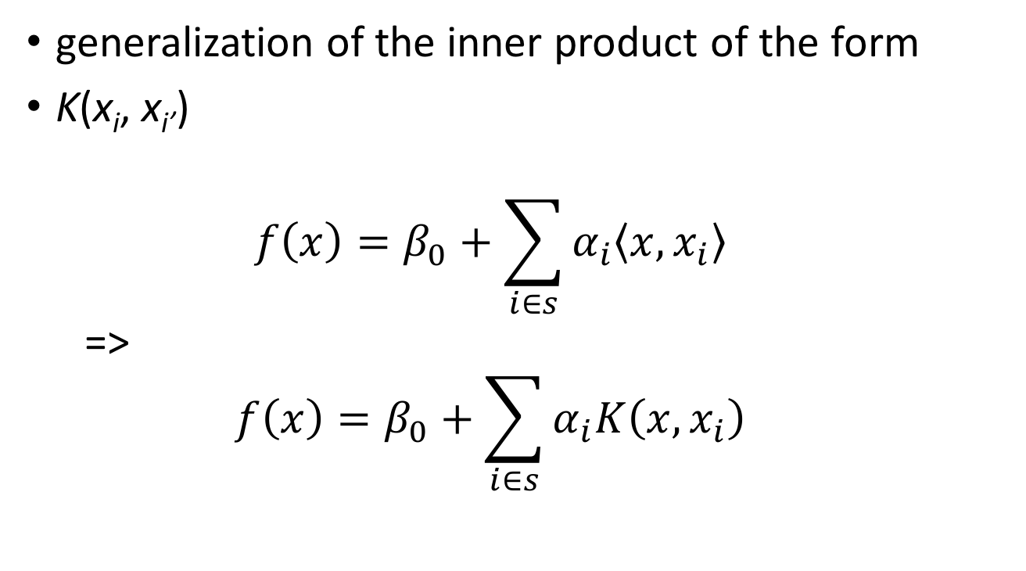
Kernel, K
generalization of the inner product of the form
K(x_{i}, x_{i’})
$$f\left(x\right)=β_{0}+\sum_{i∈s}{α_{i}\left\langle x,x_{i}\right\rangle }$$
=>
$$f\left(x\right)=β_{0}+\sum_{i∈s}{α_{i}K\left(x,x_{i}\right)}$$
An Introduction to Statistical Learning with Applications in R by Gareth James, Daniela Witten, Trevor Hastie, Robert Tibshirani

Slide 56
Kernel example
kernalExam1.R
u <- c(1,2)
v <- c(3,4)
k <- function(u,v) {
u[1]*v[1] + u[2]*v[2] +
u[1]*u[1]*v[1]*v[1] + u[2]*u[2]*v[2]*v[2] +
u[1]*u[2]*v[1]*v[2]
}
phi <- function(x) {
x <- as.numeric(x)
c(x,x*x,combn(x,2,FUN=prod))
}
Practical Data Science with R by Nina Zumel, John Mount

Slide 57
Kernel example
print(k(u,v))
print(phi(u))
print(phi(v))
print(as.numeric(phi(u) %*% phi(v)))
%*% is R’s notation for dot product or inner product
k(,) that maps pairs (u,v) to numbers is called a kernel function ⬄ there is some function phi() mapping (u,v)s to a vector space such that k(u,v) = phi(u) %*% phi(v) for all u,v.
Practical Data Science with R by Nina Zumel, John Mount

Slide 58
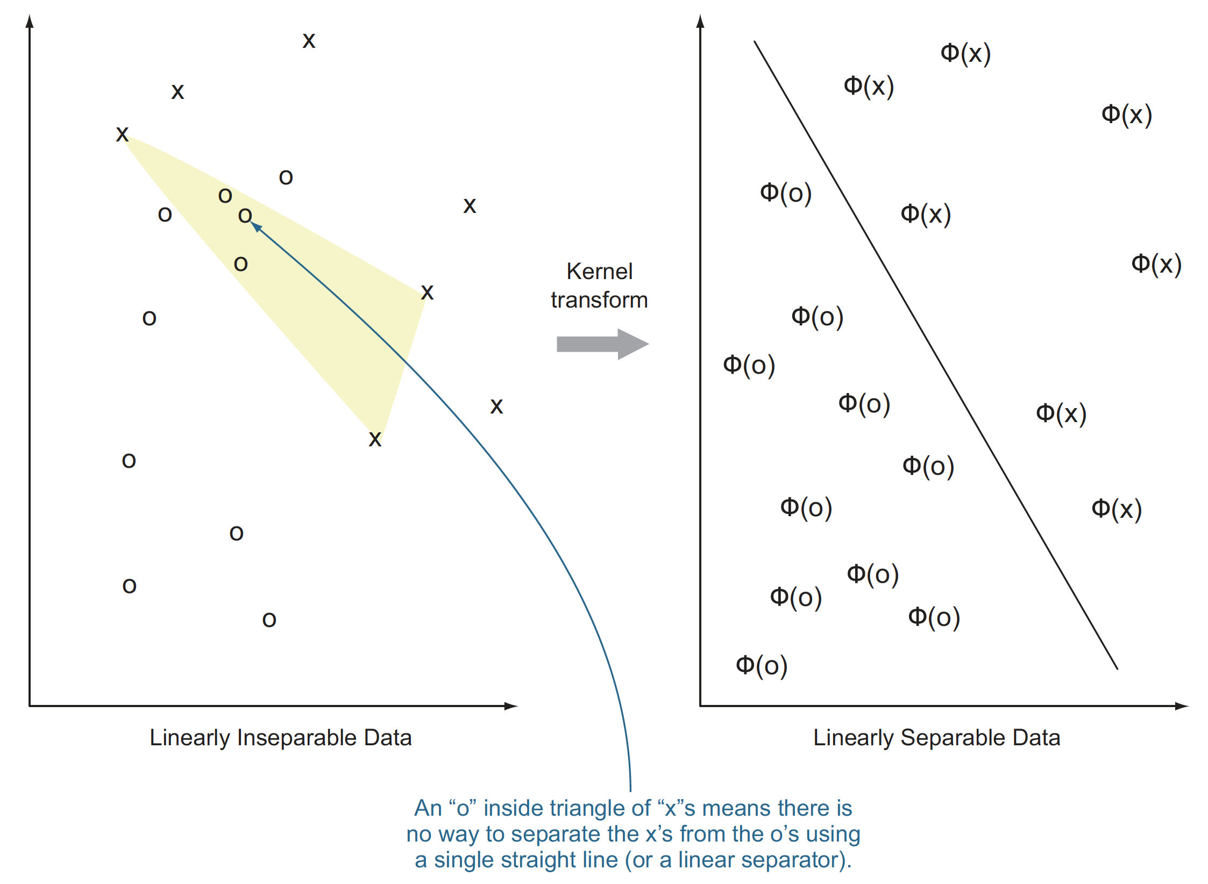
Kernel transformation
based on Cristianini and Shawe-Taylor, 2000
Figure 9.7, Practical Data Science with R by Nina Zumel, John Mount

Slide 59
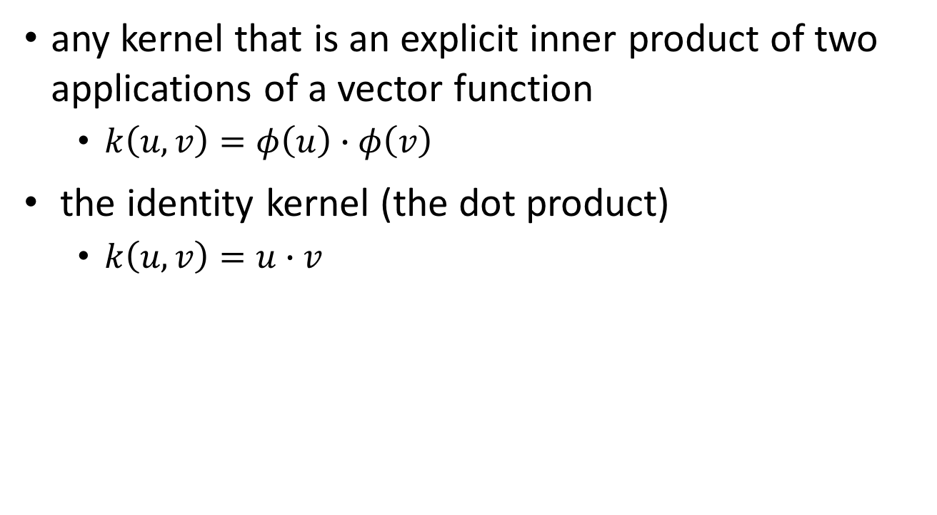
Common kernels
any kernel that is an explicit inner product of two applications of a vector function
$k\left(u,v\right)=φ\left(u\right)∙φ\left(v\right)$
the identity kernel (the dot product)
$k\left(u,v\right)=u∙v$
Practical Data Science with R by Nina Zumel, John Mount

Slide 60
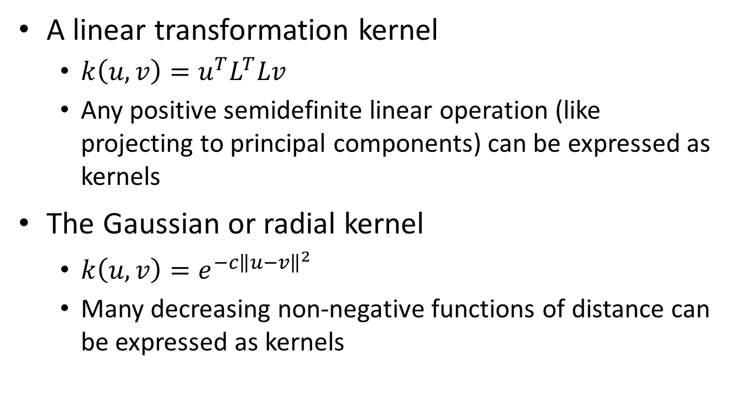
Common kernels
A linear transformation kernel
$k\left(u,v\right)=u^{T}L^{T}Lv$
Any positive semidefinite linear operation (like projecting to principal components) can be expressed as kernels
The Gaussian or radial kernel
$k\left(u,v\right)=e^{−c{\left\|u−v\right\|}^{2}}$
Many decreasing non-negative functions of distance can be expressed as kernels
Practical Data Science with R by Nina Zumel, John Mount

Slide 61
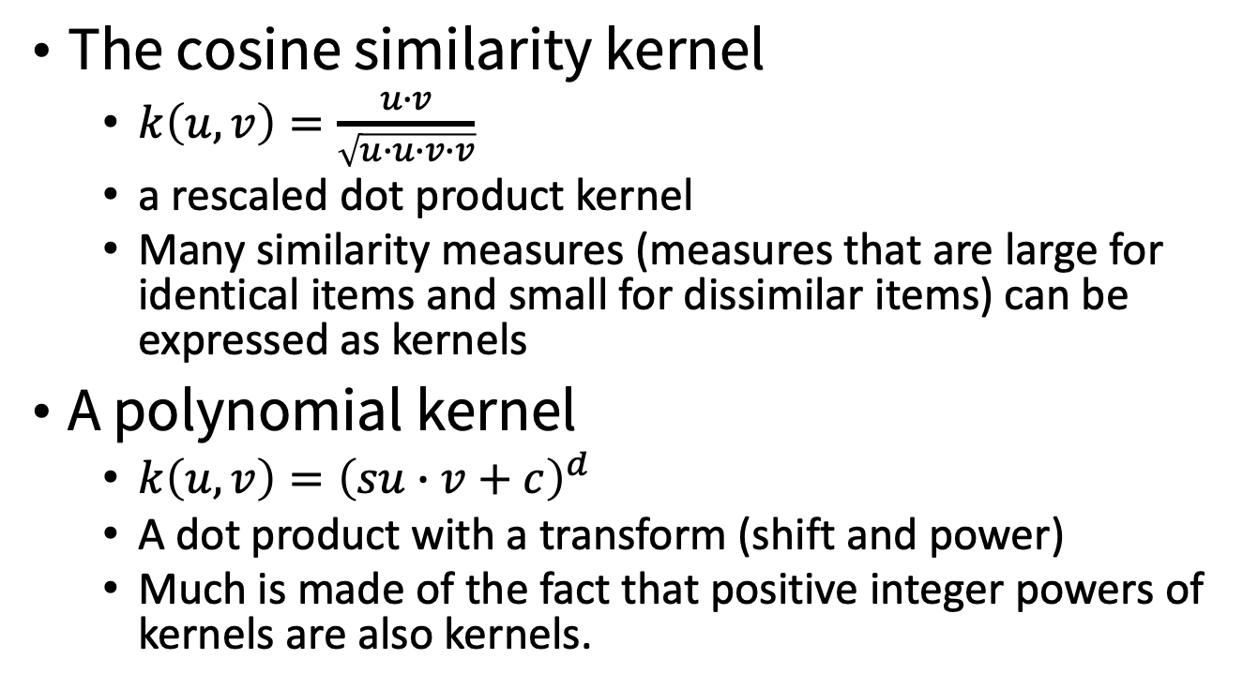
Common kernels
The cosine similarity kernel
$k\left(u,v\right)=\frac{u∙v}{\sqrt{u∙u∙v∙v}}$
a rescaled dot product kernel
Many similarity measures (measures that are large for identical items and small for dissimilar items) can be expressed as kernels
A polynomial kernel
$k\left(u,v\right)={\left(su∙v+c\right)}^{d}$
A dot product with a transform (shift and power)
Much is made of the fact that positive integer powers of kernels are also kernels.
Practical Data Science with R by Nina Zumel, John Mount

Slide 62
Prepare PUMS data
predicting the logarithm of income from a few other factors
pums/pums.R
load(“psub.Rdata”)
dtrain <- subset(psub,ORIGRANDGROUP >= 500)
dtest <- subset(psub,ORIGRANDGROUP < 500)
Practical Data Science with R by Nina Zumel, John Mount

Slide 63
Applying stepwise linear regression to PUMS data
the linear regression model we’re building be stepwise improved, which is a powerful automated procedure for removing variables that don’t seem to have significant impacts (can improve generalization performance).
m1 <- step( lm(log(PINCP,base=10) ~ AGEP + SEX + COW + SCHL, data=dtrain), direction='both')
rmse <- function(y, f) { sqrt(mean( (y-f)^2 )) }
print(rmse(log(dtest$PINCP,base=10), predict(m1,newdata=dtest)))
Practical Data Science with R by Nina Zumel, John Mount

Slide 64
Step function
Choose a model by AIC in a Stepwise Algorithm
step uses add1 and drop1 repeatedly; it will work for any method for which they work, and that is determined by having a valid method for extractAIC. When the additive constant can be chosen so that AIC is equal to Mallows' Cp, this is done and the tables are labelled appropriately.
http://rpubs.com/skydome20/R-Note18-Subsets_Shrinkage_Methods

Slide 65
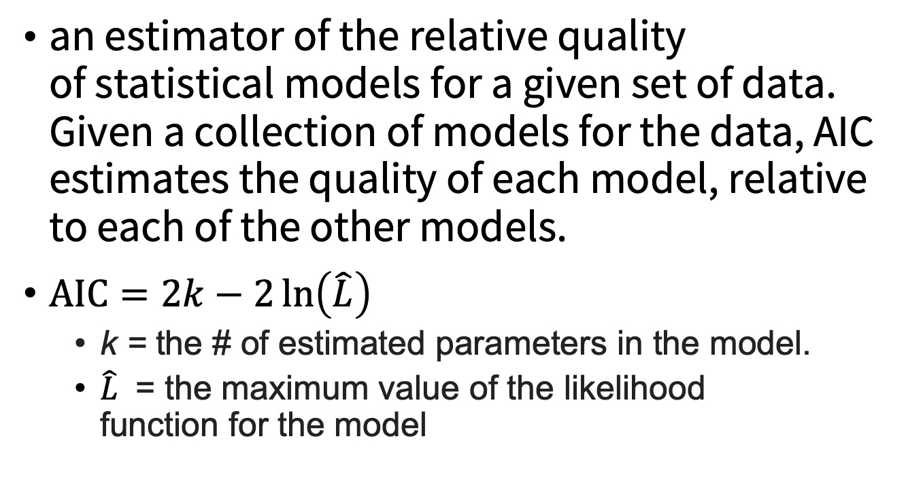
Akaike Information Criterion (AIC)
an estimator of the relative quality of statistical models for a given set of data. Given a collection of models for the data, AIC estimates the quality of each model, relative to each of the other models.
$\text{AIC}=2k−2\ln\left(\hat{L}\right)$
k = the # of estimated parameters in the model.
$\hat{L}$ = the maximum value of the likelihood function for the model
Credit by https://en.wikipedia.org/wiki/Akaike_information_criterion

Slide 66
Applying an example explicit kernel transform
kernalExam2.R
modelMatrix <- model.matrix(~ 0 + AGEP + SEX + COW + SCHL,psub)
colnames(modelMatrix) <- gsub('[^a-zA-Z0-9]+','_',colnames(modelMatrix))
Practical Data Science with R by Nina Zumel, John Mount

Slide 67
Applying an example explicit kernel transform
phi <- function(x) {
x <- as.numeric(x)
c(x,x*x,combn(x,2,FUN=prod))
}
phiNames <- function(n) {
c(n,paste(n,n,sep=':'),
combn(n,2,FUN=function(x) {paste(x,collapse=':')}))
}
pM <- t(apply(modelMatrix,1,phi))
vars <- phiNames(colnames(modelMatrix))
vars <- gsub('[^a-zA-Z0-9]+','_',vars)
colnames(pM) <- vars
Practical Data Science with R by Nina Zumel, John Mount

Slide 68
Applying an example explicit kernel transform
pM <- as.data.frame(pM)
pM$PINCP <- psub$PINCP
pM$ORIGRANDGROUP <- psub$ORIGRANDGROUP
pMtrain <- subset(pM,ORIGRANDGROUP >= 500)
pMtest <- subset(pM,ORIGRANDGROUP < 500)
Practical Data Science with R by Nina Zumel, John Mount

Slide 69
Modeling using the explicit kernel transform
formulaStr2 <- paste('log(PINCP,base=10)',paste(vars,collapse='+'),sep='~')
m2 <- lm(as.formula(formulaStr2),data=pMtrain)
coef2 <- summary(m2)$coefficients
Practical Data Science with R by Nina Zumel, John Mount

Slide 70
Modeling using the explicit kernel transform
interestingVars <- setdiff(rownames(coef2)[coef2[,'Pr(>|t|)']<0.01],'(Intercept)')
interestingVars <- union(colnames(modelMatrix),interestingVars)
formulaStr3 <- paste('log(PINCP,base=10)',
paste(interestingVars,collapse=' + '),sep=' ~ ')
m3 <- step(lm(as.formula(formulaStr3),data=pMtrain),direction='both')
print(rmse(log(pMtest$PINCP,base=10),predict(m3,newdata=pMtest)))
Practical Data Science with R by Nina Zumel, John Mount

Slide 71
Inspecting the results of the explicit kernel model
print(summary(m3))
The model is using AGEP*AGEP to build a non-monotone relation between age and log income.
Explicit phi() kernel notation adds some capabilities, but algorithms that are designed to work directly with implicit kernel definitions in k(,) notation can be much more powerful. => support vector machine
Practical Data Science with R by Nina Zumel, John Mount

Slide 72
Kernel takeaways
Kernels provide a systematic way of creating interactions and other synthetic variables that are combinations of individual variables.
The goal of kernelizing is to lift the data into a space where the data is separable, or where linear methods can be used directly.
Practical Data Science with R by Nina Zumel, John Mount

Slide 73
SVMs

Slide 74
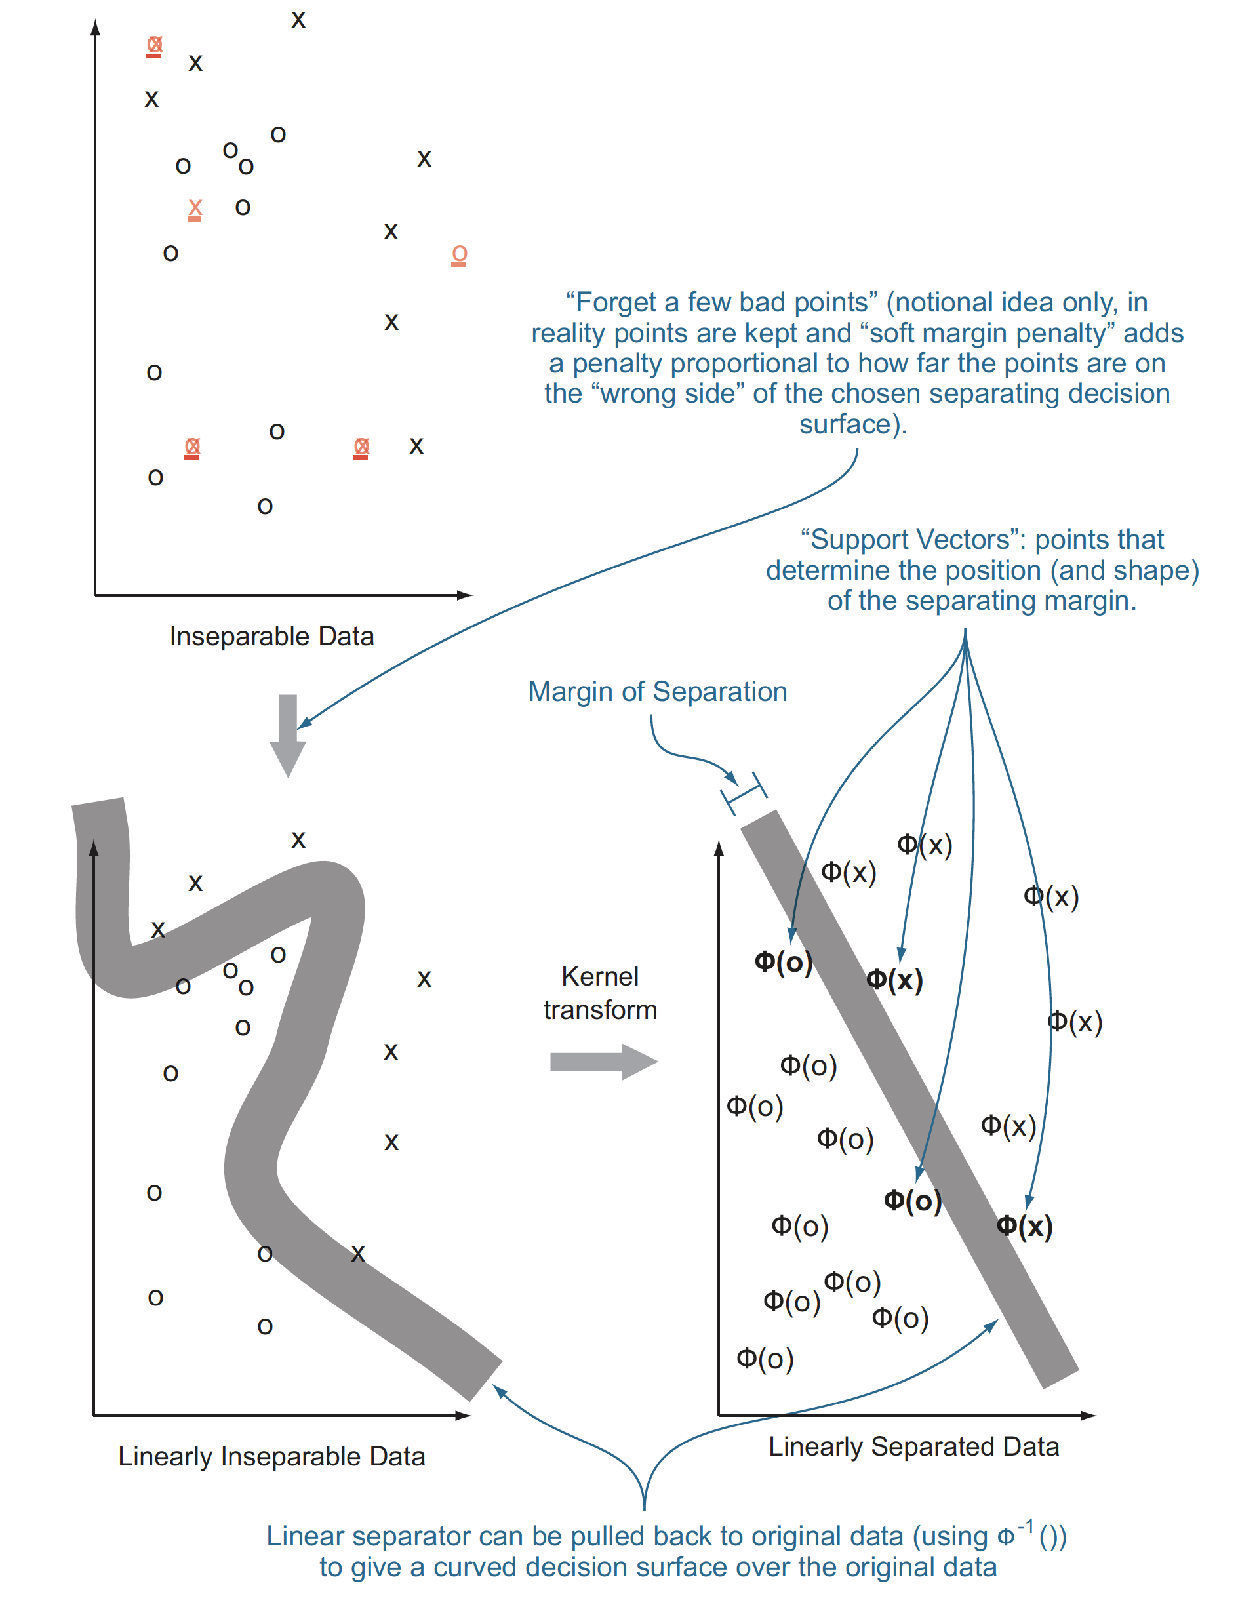
Using SVMs to model complicated decision boundaries
idea : use entire training examples as classification landmarks (called support vectors).
Figure 9.8, Practical Data Science with R by Nina Zumel, John Mount

Slide 75
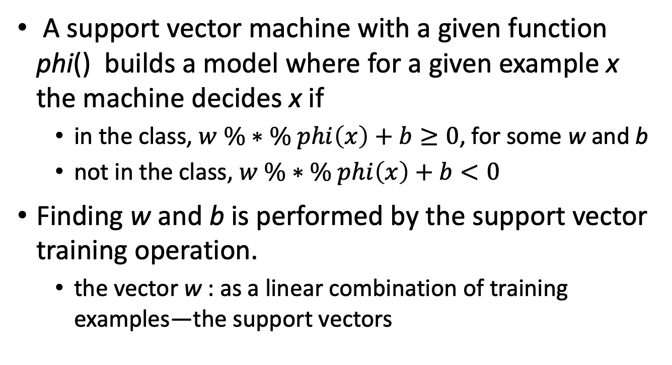
Understanding support vector machines
A support vector machine with a given function phi() builds a model where for a given example x the machine decides x if
in the class, $w \%∗\% phi\left(x\right)+b≥0$, for some w and b
not in the class, $w \%∗\% phi\left(x\right)+b<0$
Finding w and b is performed by the support vector training operation.
the vector w : as a linear combination of training examples—the support vectors
Practical Data Science with R by Nina Zumel, John Mount

Slide 76
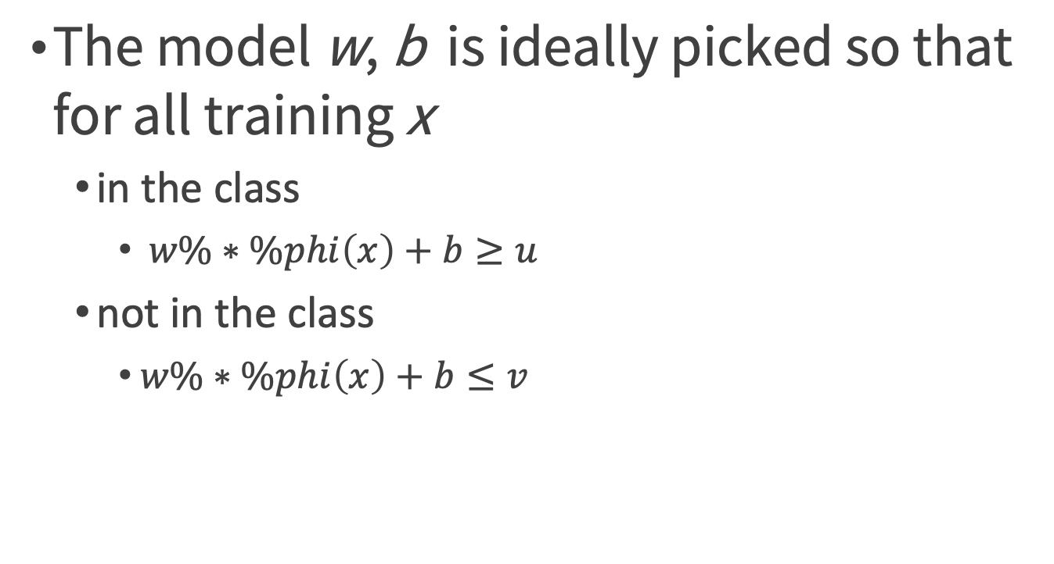
Notions
The model w, b is ideally picked so that for all training x
in the class
$w\%∗\%phi\left(x\right)+b≥u$
not in the class
$w\%∗\%phi\left(x\right)+b≤v$
Practical Data Science with R by Nina Zumel, John Mount

Slide 77
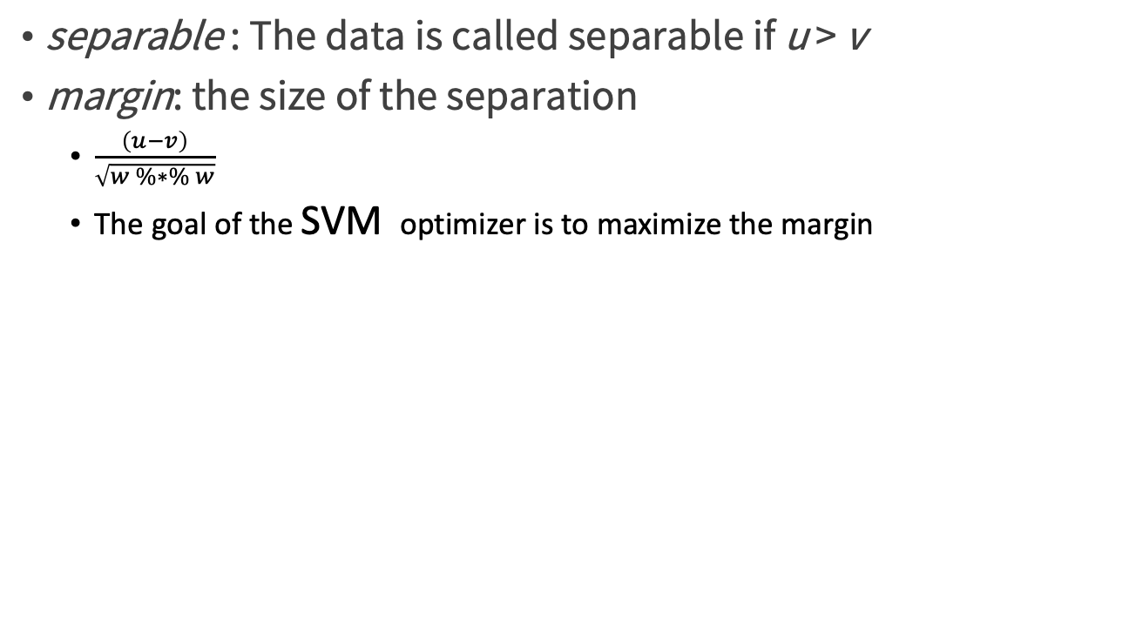
Maximize the margin
separable : The data is called separable if u > v
margin: the size of the separation
$\frac{\left(u−v\right)}{\sqrt{w \%∗\% w}}$
The goal of the SVM optimizer is to maximize the margin
Practical Data Science with R by Nina Zumel, John Mount

Slide 78
The Support Vectors
how do we evaluate the final model
w %*% phi(x) + b
there’s always a set of vectors s₁,...,s_{m} and numbers a₁,...,a_{m} such that
w = sum(a₁*phi(s₁),...,a_{m}*phi(s_{m}))
w %*% phi(x) + b = sum(a₁*k(s₁,x),...,a_{m}*k(s_{m},x)) + b
Practical Data Science with R by Nina Zumel, John Mount

Slide 79
The Support Vectors
The work of the support vector training algorithm is to find
the vectors s₁,...,s_{m}
the scalars a₁,...,a_{m}
the offset b
Practical Data Science with R by Nina Zumel, John Mount

Slide 80
Spiral example
SVMexam1.R
library('kernlab')
data('spirals')
sc <- specc(spirals, centers = 2)
s <- data.frame(x=spirals[,1],y=spirals[,2], class=as.factor(sc))
Practical Data Science with R by Nina Zumel, John Mount

Slide 81
Spiral example
SVMexam1.R
library('ggplot2')
ggplot(data=s) +
geom_text(aes(x=x,y=y,label=class,color=class)) +
coord_fixed() + theme_bw() + theme(legend.position='none')
Practical Data Science with R by Nina Zumel, John Mount

Slide 82
Support vector machines with the wrong kernel
using the identity or dot-product kernel
set.seed(2335246L)
s$group <- sample.int(100,size=dim(s)[[1]],replace=T)
sTrain <- subset(s,group>10)
sTest <- subset(s,group<=10)
mSVMV <- ksvm(class~x+y,data=sTrain,kernel='vanilladot')
sTest$predSVMV <- predict(mSVMV,newdata=sTest,type='response')
Practical Data Science with R by Nina Zumel, John Mount

Slide 83
Support vector machines with the wrong kernel
ggplot() +
geom_text(data=sTest,aes(x=x,y=y, label=predSVMV),size=12) +
geom_text(data=s,aes(x=x,y=y,
label=class,color=class),alpha=0.7) + coord_fixed() +
theme_bw() + theme(legend.position='none')
Practical Data Science with R by Nina Zumel, John Mount

Slide 84
Support vector machines with a good kernel
the Gaussian or radial kernel
mSVMG <- ksvm(class~x+y,data=sTrain,kernel='rbfdot')
sTest$predSVMG <- predict(mSVMG,newdata=sTest,type='response')
ggplot() +
geom_text(data=sTest,aes(x=x,y=y, label=predSVMG),size=12) +
geom_text(data=s,aes(x=x,y=y,label=class,color=class),alpha=0.7) +
coord_fixed() + theme_bw() + theme(legend.position='none')
Practical Data Science with R by Nina Zumel, John Mount

Slide 85
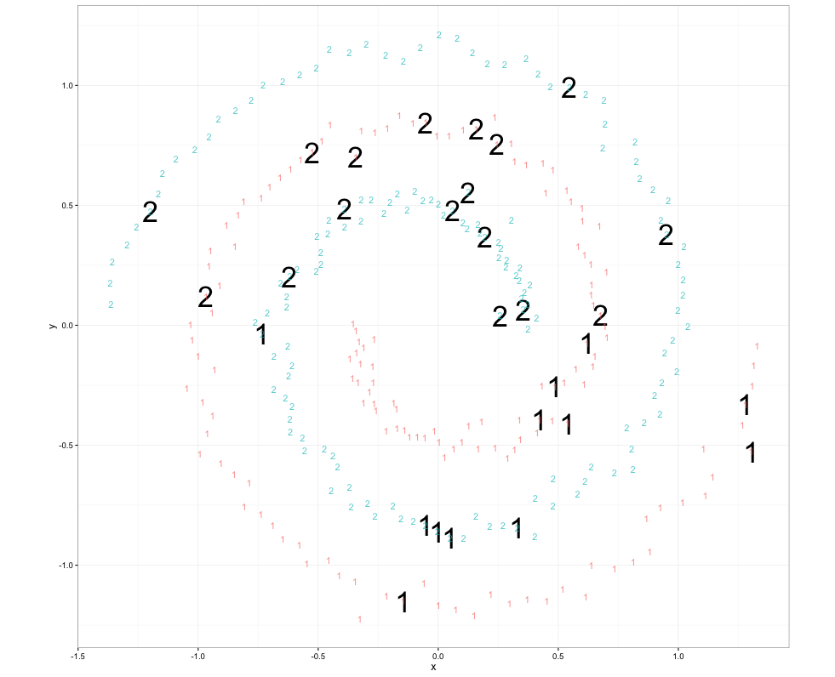
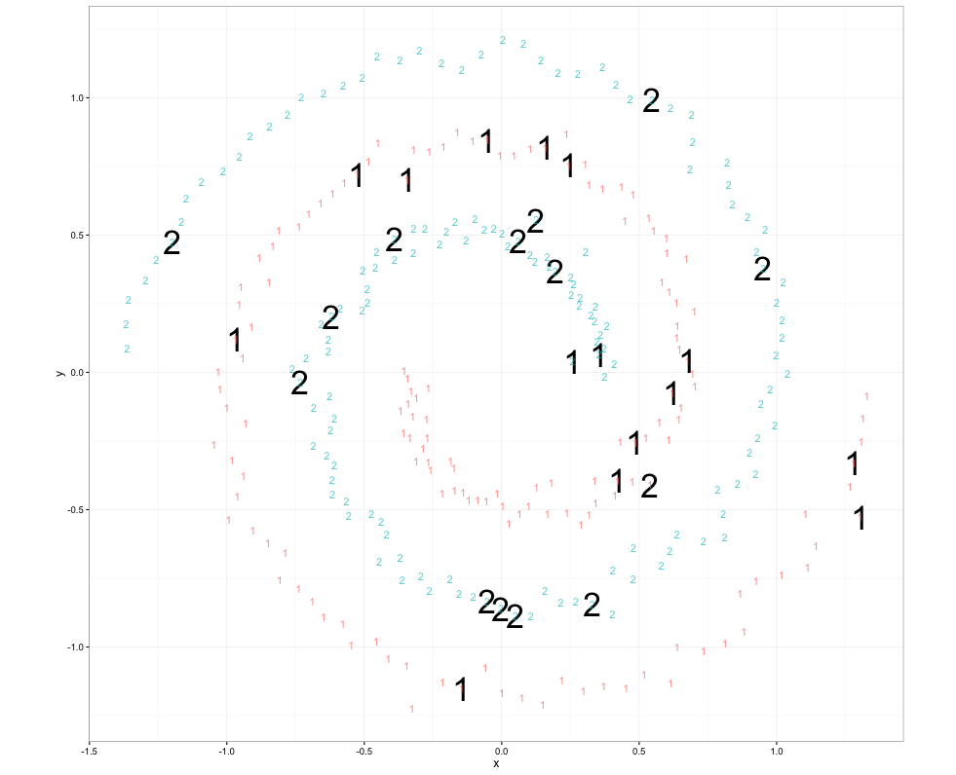
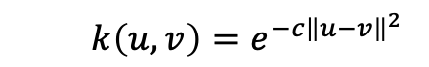
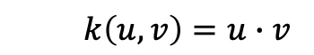
Identity vs Gaussian kernel in the spirals data
$$k\left(u,v\right)=u∙v$$
$$k\left(u,v\right)=e^{−c{\left\|u−v\right\|}^{2}}$$
Figure 9.10、9.11, Practical Data Science with R by Nina Zumel, John Mount

Slide 86
Using GLM on Spambase data
spam/predSpam_logistic.R
spamD <- read.table('spamD.tsv',header=T,sep='\t')
spamTrain <- subset(spamD,spamD$rgroup>=10)
spamTest <- subset(spamD,spamD$rgroup<10)
spamVars <- setdiff(colnames(spamD),list('rgroup','spam'))
Practical Data Science with R by Nina Zumel, John Mount

Slide 87
Using GLM on Spambase data
spam/predSpam_logistic.R
spamFormula <- as.formula(paste('spam=="spam"', paste(spamVars,collapse=' + '),sep=' ~ '))
spamModel <- glm(spamFormula,family=binomial(link='logit'), data=spamTrain)
#predict
spamTest$pred <- predict(spamModel,newdata=spamTest, type='response')
# confusion matrix
print(with(spamTest, table(y=spam,glPred=pred>=0.5)))
Practical Data Science with R by Nina Zumel, John Mount

Slide 88
Applying an SVM to the Spambase example
spam/predSpam_SVM.R
library('kernlab')
spamFormulaV <- as.formula(paste('spam',
paste(spamVars,collapse=' + '),sep=' ~ '))
svmM <- ksvm(spamFormulaV,data=spamTrain, kernel='rbfdot',
C=10,prob.model=T,cross=5,
class.weights=c('spam'=1,'non-spam'=10)
)
setting C=10 (which tells the SVM to prefer training accuracy and margin over model simplicity)
Setting class.weights (telling the SVM to prefer precision over recall)
Practical Data Science with R by Nina Zumel, John Mount

Slide 89
Applying an SVM to the Spambase example
spam/predSpam_SVM.R
spamTest$svmPred <- predict(svmM,newdata=spamTest,type='response')
print(with(spamTest,table(y=spam,svmPred=svmPred)))
Practical Data Science with R by Nina Zumel, John Mount

Slide 90
Printing the SVM results summary
print(svmM)
Support Vector Machine object of class "ksvm"
SV type: C-svc (classification)
factors : the ksvm call only performs classification
a Boolean or numeric quantity : the quantity to be predicted, the ksvm call may return a regression model (instead of the desired classification model).
parameter : cost C = 10
Gaussian Radial Basis kernel function.
Hyperparameter : sigma = 0.0299836801848002
Practical Data Science with R by Nina Zumel, John Mount

Slide 91
Printing the SVM results summary
print(svmM)
Number of Support Vectors : 1118
1,118 training examples were retained as support vectors => too complicated a model
much larger than the original number of variables (57) and with an order of magnitude of the number of training examples (4143).
Objective Function Value : -4642.236
Training error : 0.028482
Cross validation error : 0.076998
Probability model included.
Practical Data Science with R by Nina Zumel, John Mount

Slide 92
Comparing results
the SVM model has a lower false positive count of 9 than the GLM ’s 14.
setting C=10 (which tells the SVM to prefer training accuracy and margin over model simplicity)
Setting class.weights (telling the SVM to prefer precision over recall)
How about GLM model’s top 162 spam candidates?
sameCut <- sort(spamTest$pred)[length(spamTest$pred)-162]
print(with(spamTest,table(y=spam,glPred=pred>sameCut)))
Practical Data Science with R by Nina Zumel, John Mount

Slide 93
Support vector machine takeaways
SVMs are a kernel-based classification approach where the kernels are represented in terms of a (possibly very large) subset of the training examples.
SVMs try to lift the problem into a space where the data is linearly separable (or as near to separable as possible).
SVMs are useful in cases where the useful interactions or other combinations of input variables aren’t known in advance. They’re also useful when similarity is strong evidence of belonging to the same class.
Practical Data Science with R by Nina Zumel, John Mount

Slide 94
Summary
Generalized additive models—To remove the (false) assumption that each model feature contributes to the model in a monotone fashion
Bagging and random forests—To reduce the sensitivity of models to early modeling choices and reduce modeling variance
Kernel methods—To introduce new features that are nonlinear combinations of existing features, increasing the power of our model
Support vector machines—To use training examples as landmarks (support vectors), again increasing the power of our model
Practical Data Science with R by Nina Zumel, John Mount

Slide 95
Key takeaways
Use advanced methods to fix specific problems, not for the excitement.
Advanced methods can help fix overfit, variable interactions, non-additive relations, and unbalanced distributions, but not lack of features or data.
Which method is best depends on the data, and there are many advanced methods to try.
Only deliver advanced models if you can show they are outperforming simpler methods.
Practical Data Science with R by Nina Zumel, John Mount

Slide 96
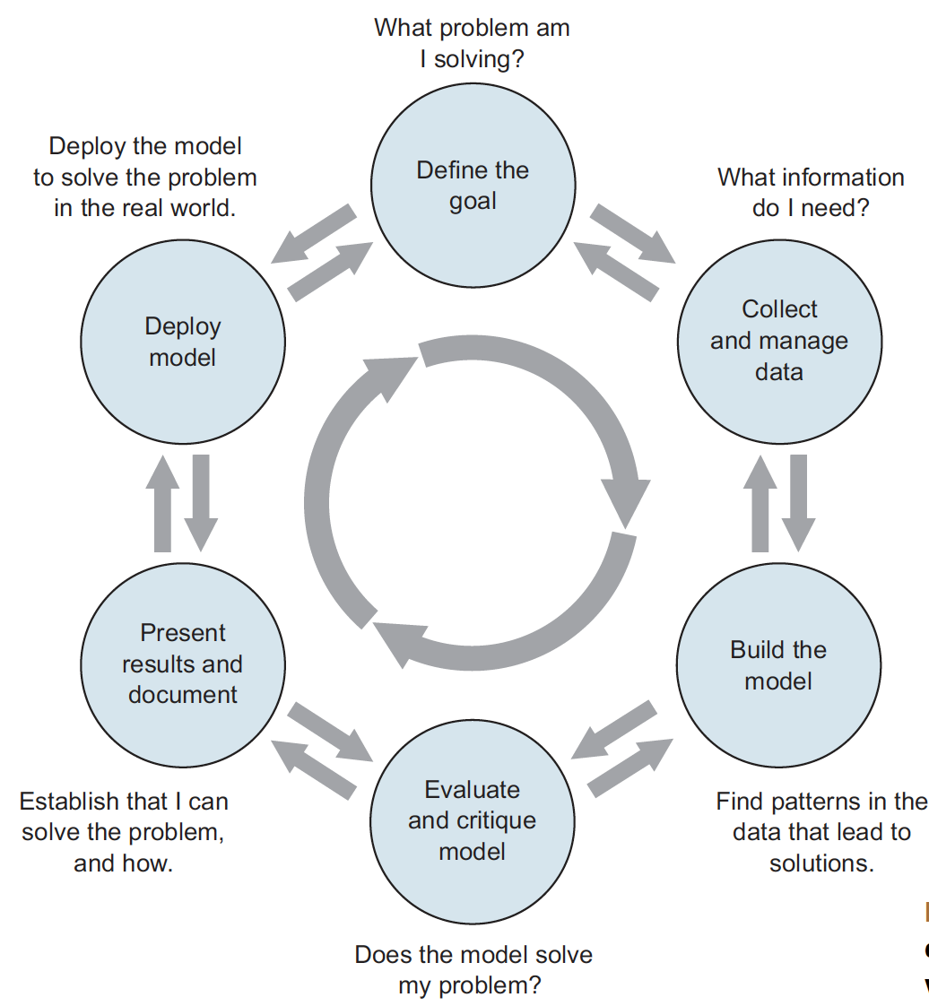
Course Review
Figure 1.1, Practical Data Science with R by Nina Zumel, John Mount

Slide 97

Thank You Any Question?

